Slide 1

Imaging and Analysis of Post-processing for Discrete Element Method and its Application
Algorithm Description
Numerical Simulation Experiment
Nanjing University
WEI Huajing
22/05/2020

Slide 2
Content
Background
Algorithm
Experiment
Discussion
Conclusion

Slide 3
Content
Background
Algorithm
Experiment
Discussion
Conclusion

Slide 4
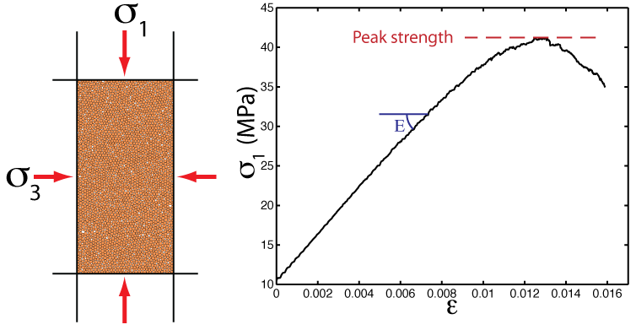
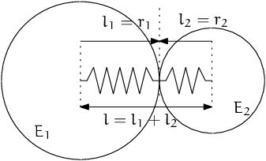
Background
DEM: Discrete Element Model
Microgranular system for macroscopic object
Based on Newtonian mechanics
Masses of computation

Slide 5
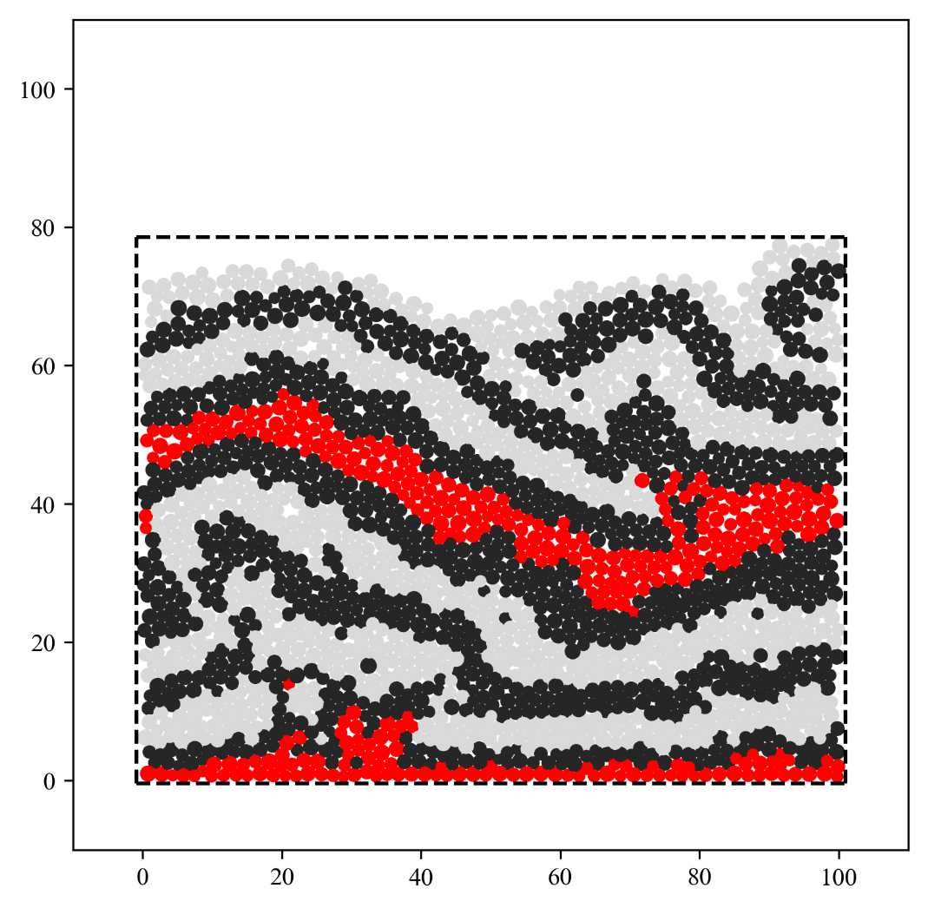
Graphics
x1, y1, z1, r1…
x2, y2, z2, r2…
x3 y3, z3, r3…
…, …, …, …, ...
…, …, …, …, ...
…, …, …, …, ...
xn, yn, zn, rn…
text

Slide 6

Image
1,1,1,1,1,1,…1,1,2
0,0,0,0,…0,0,0
1,1,2,2,2,…1,1,1
…, …, …, …, ...
…, …, …, …, ...
…, …, …, …, ...
2,2,2,1,1…,1,2,2
matrix

Slide 7
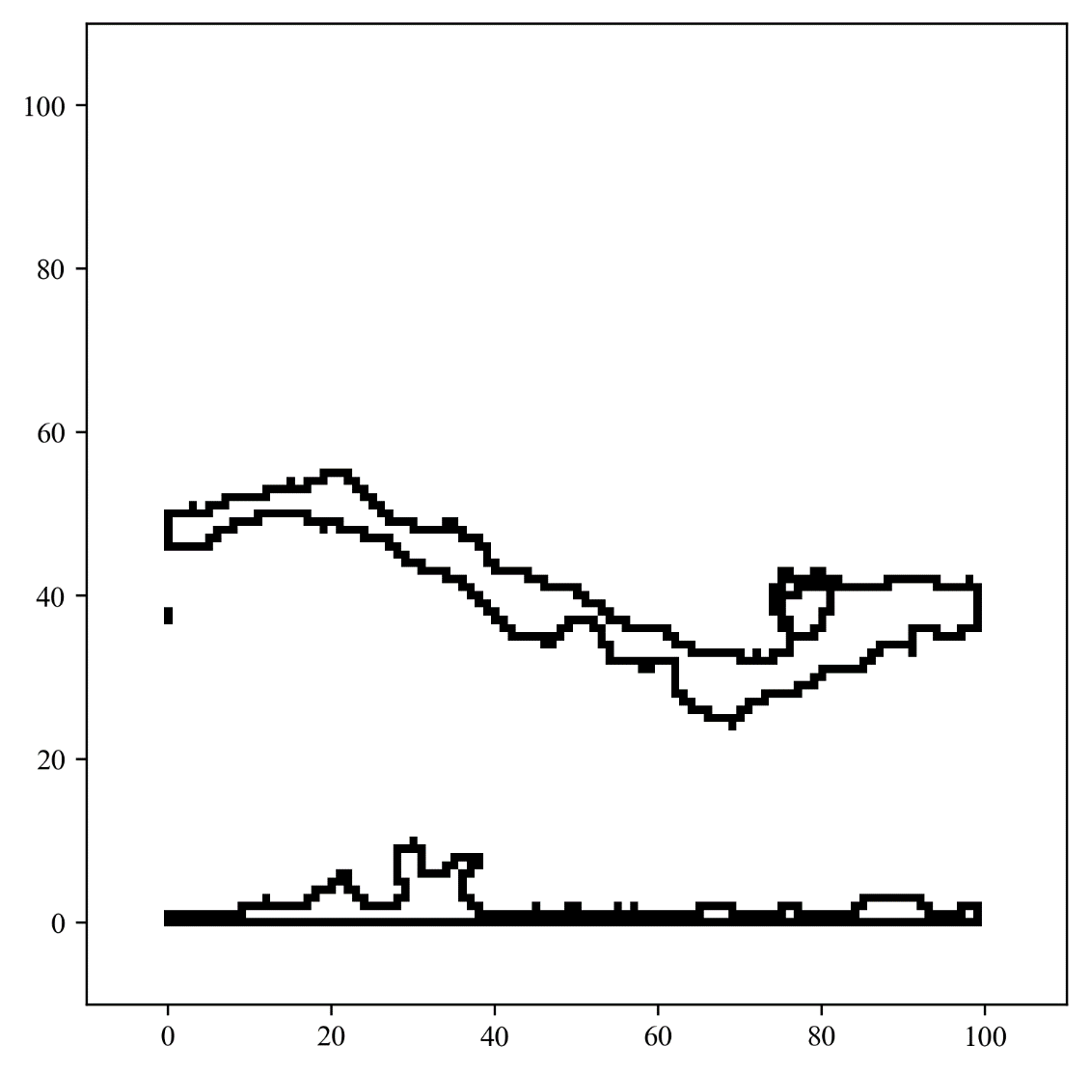
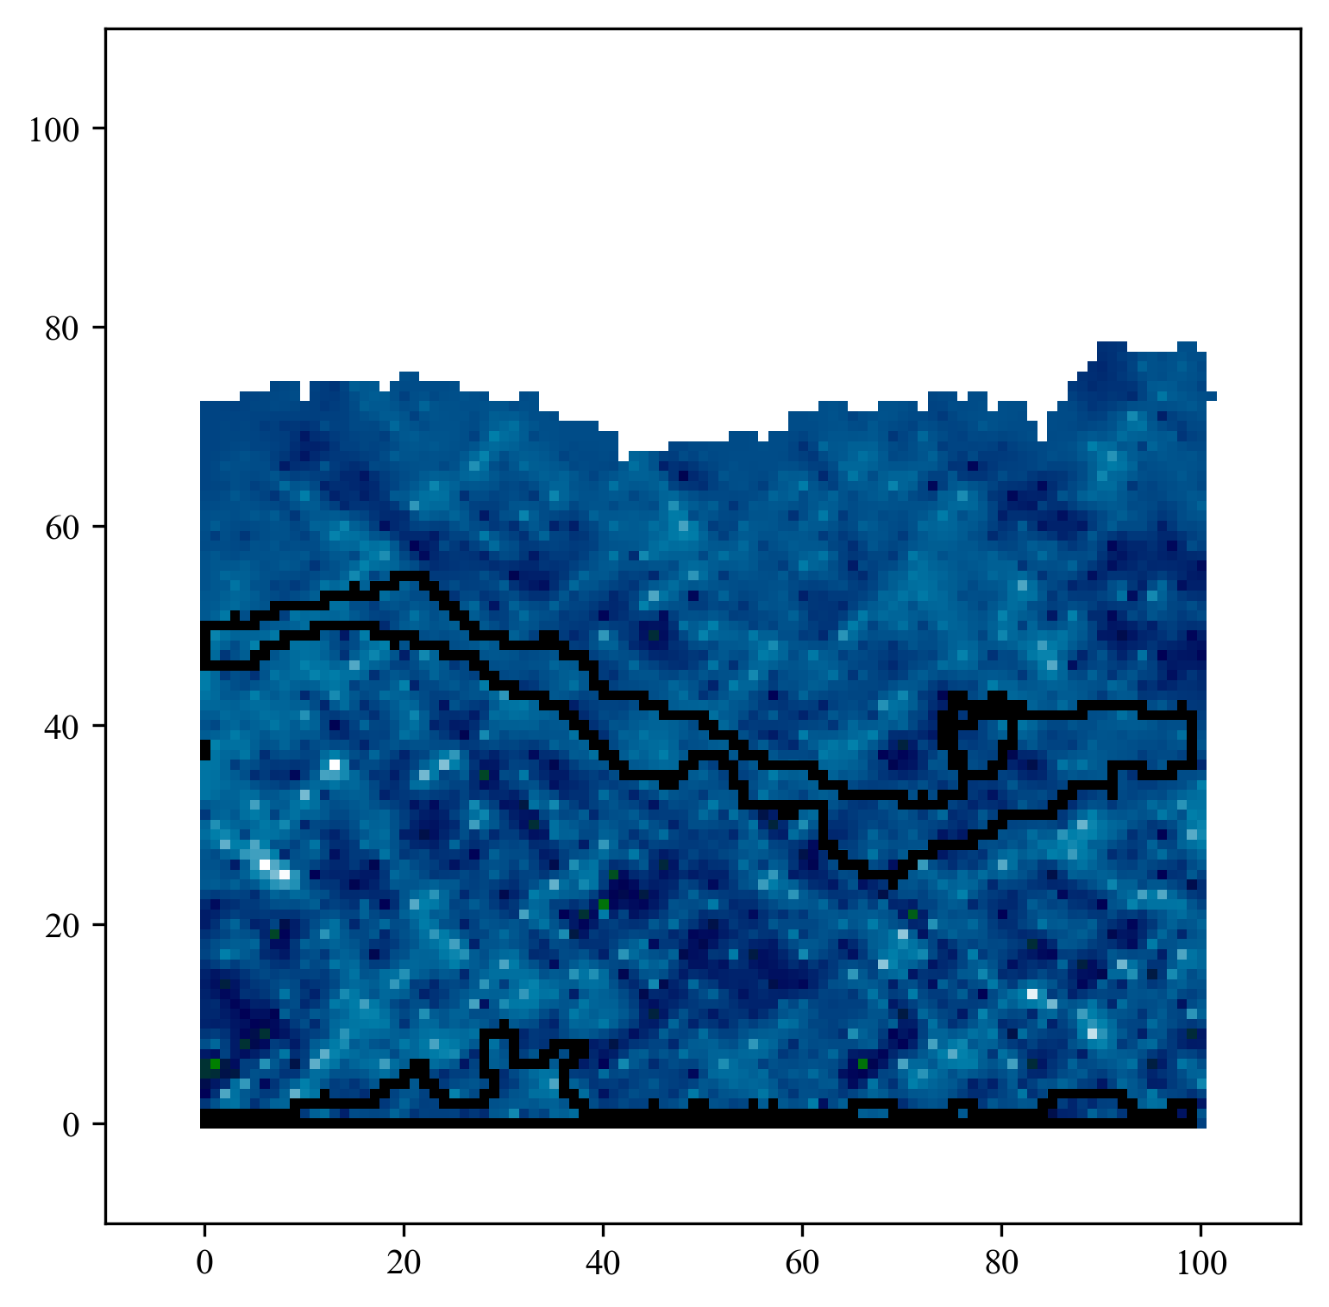
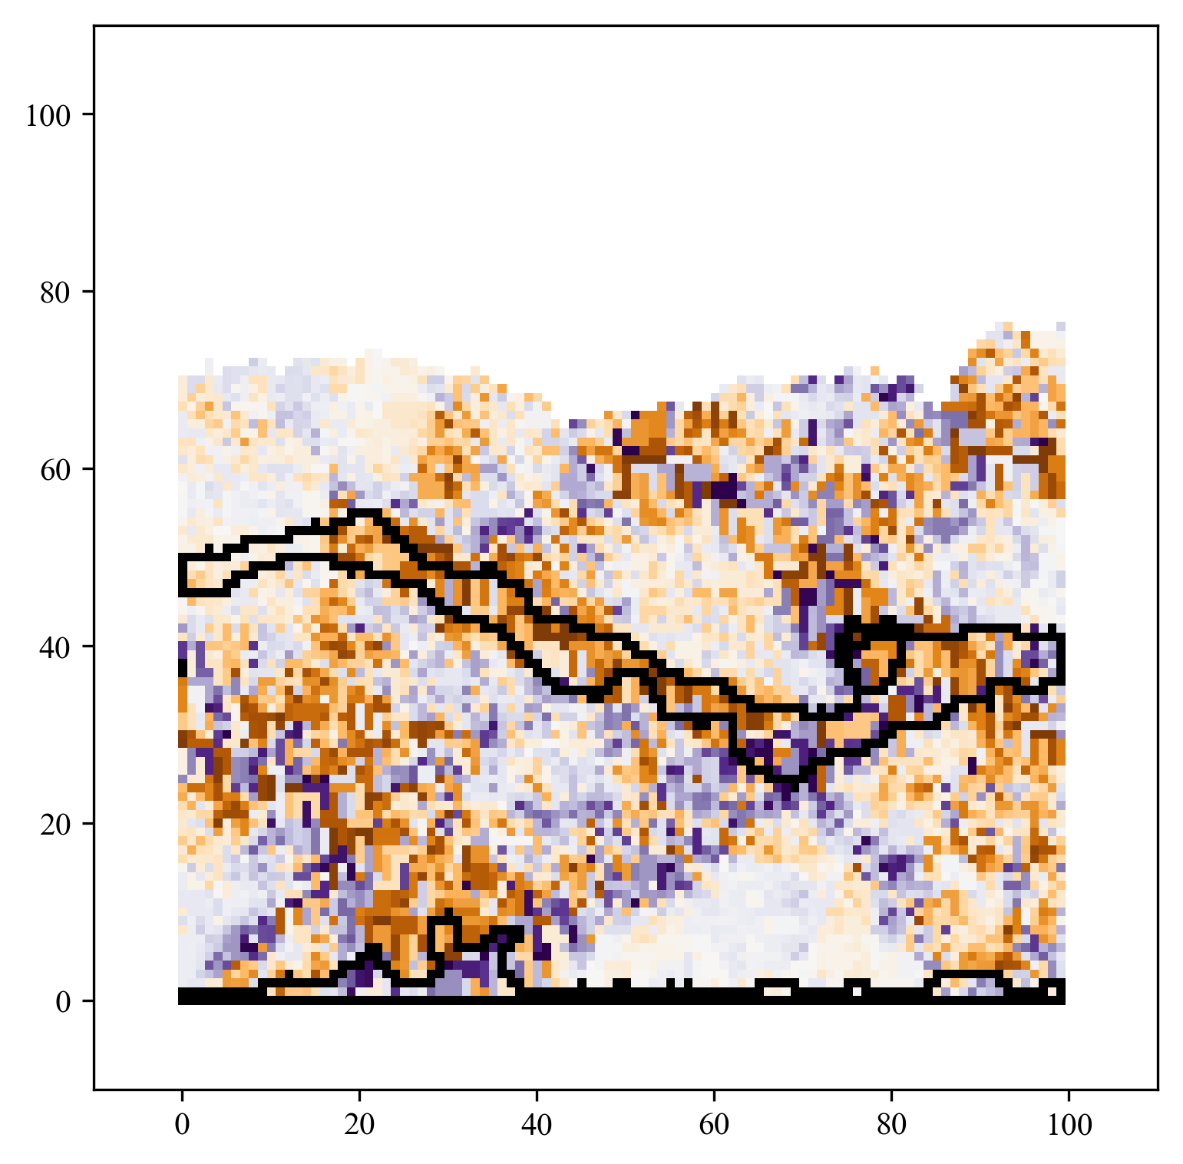
Importance

Slide 8
Content
Background
Algorithm
Experiment
Discussion
Conclusion

Slide 9

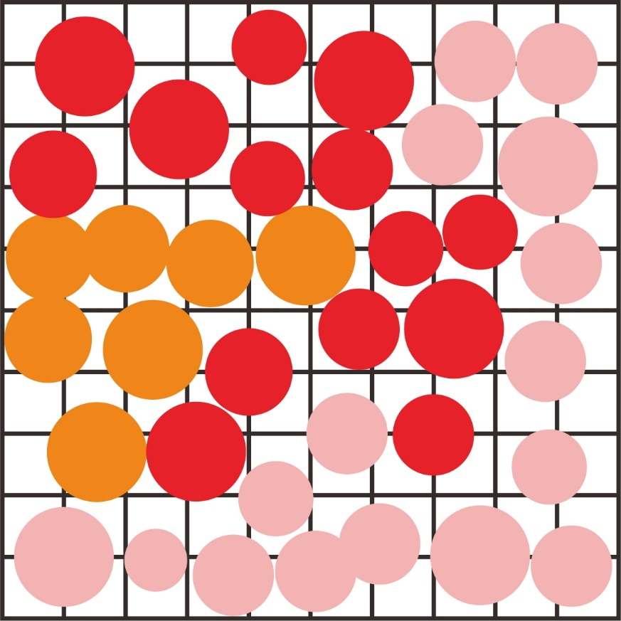


Algorithm
Graphics to Image: String to Matrix
Color Mapping
Rasterization
Boundary Extraction
Spatial Interpolation
Erosion and Expansion
Gaussian Filtering
GitHub: https://github.com/jerryweihuajing/Post-Processing

Slide 10

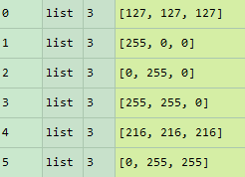
Color Mapping
GitHub: https://github.com/jerryweihuajing/Post-Processing

Slide 11
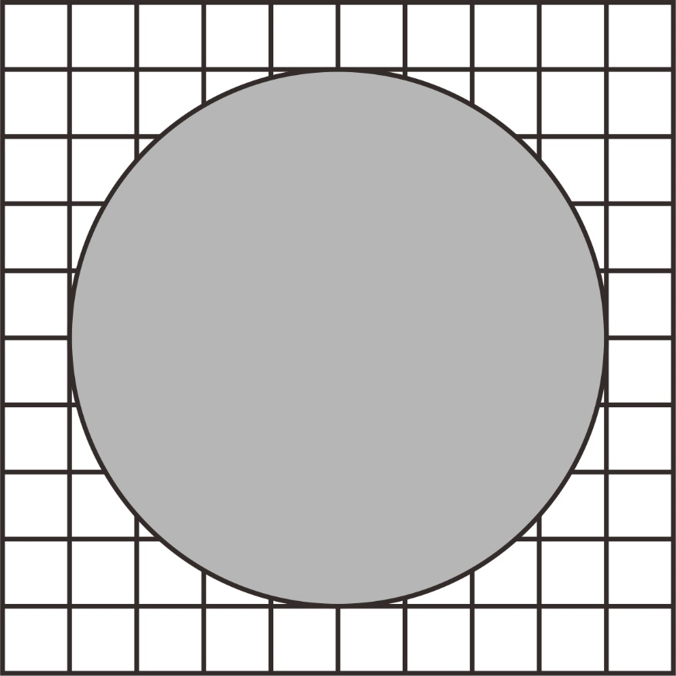
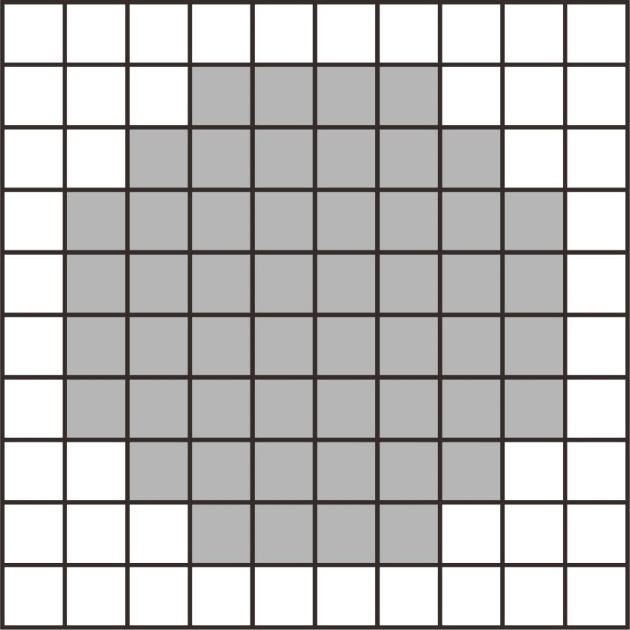
Rasterization
GitHub: https://github.com/jerryweihuajing/Post-Processing

Slide 12
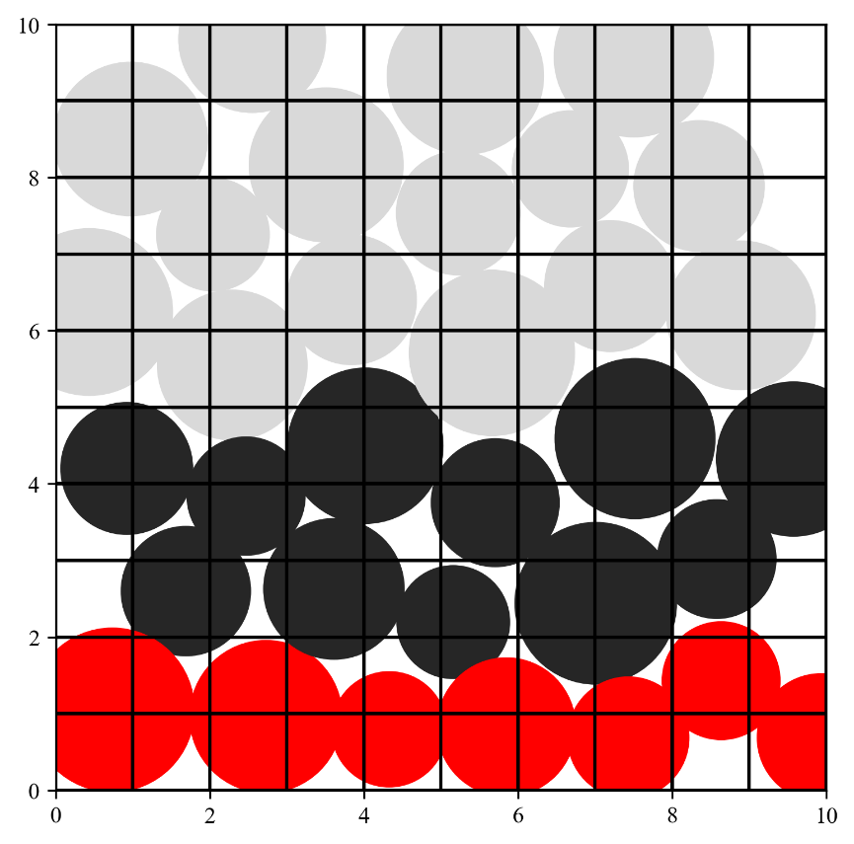
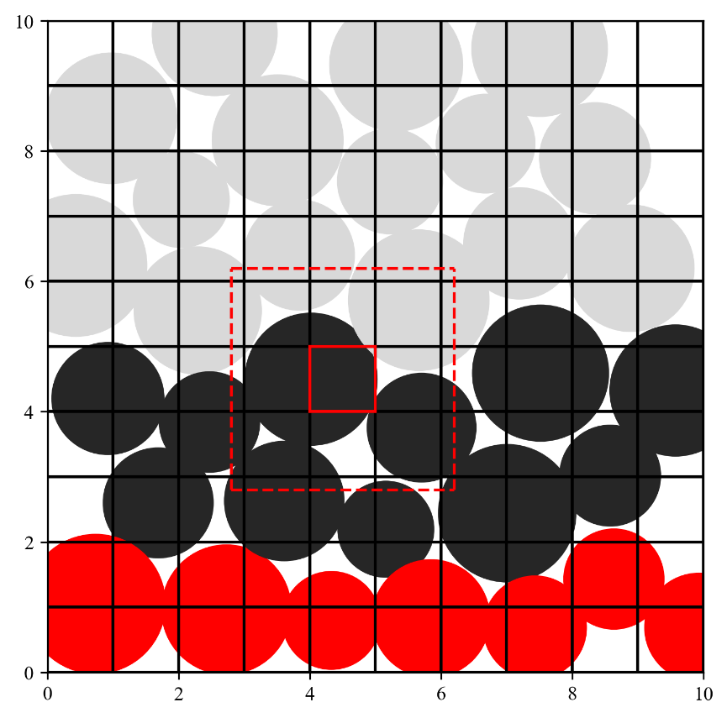
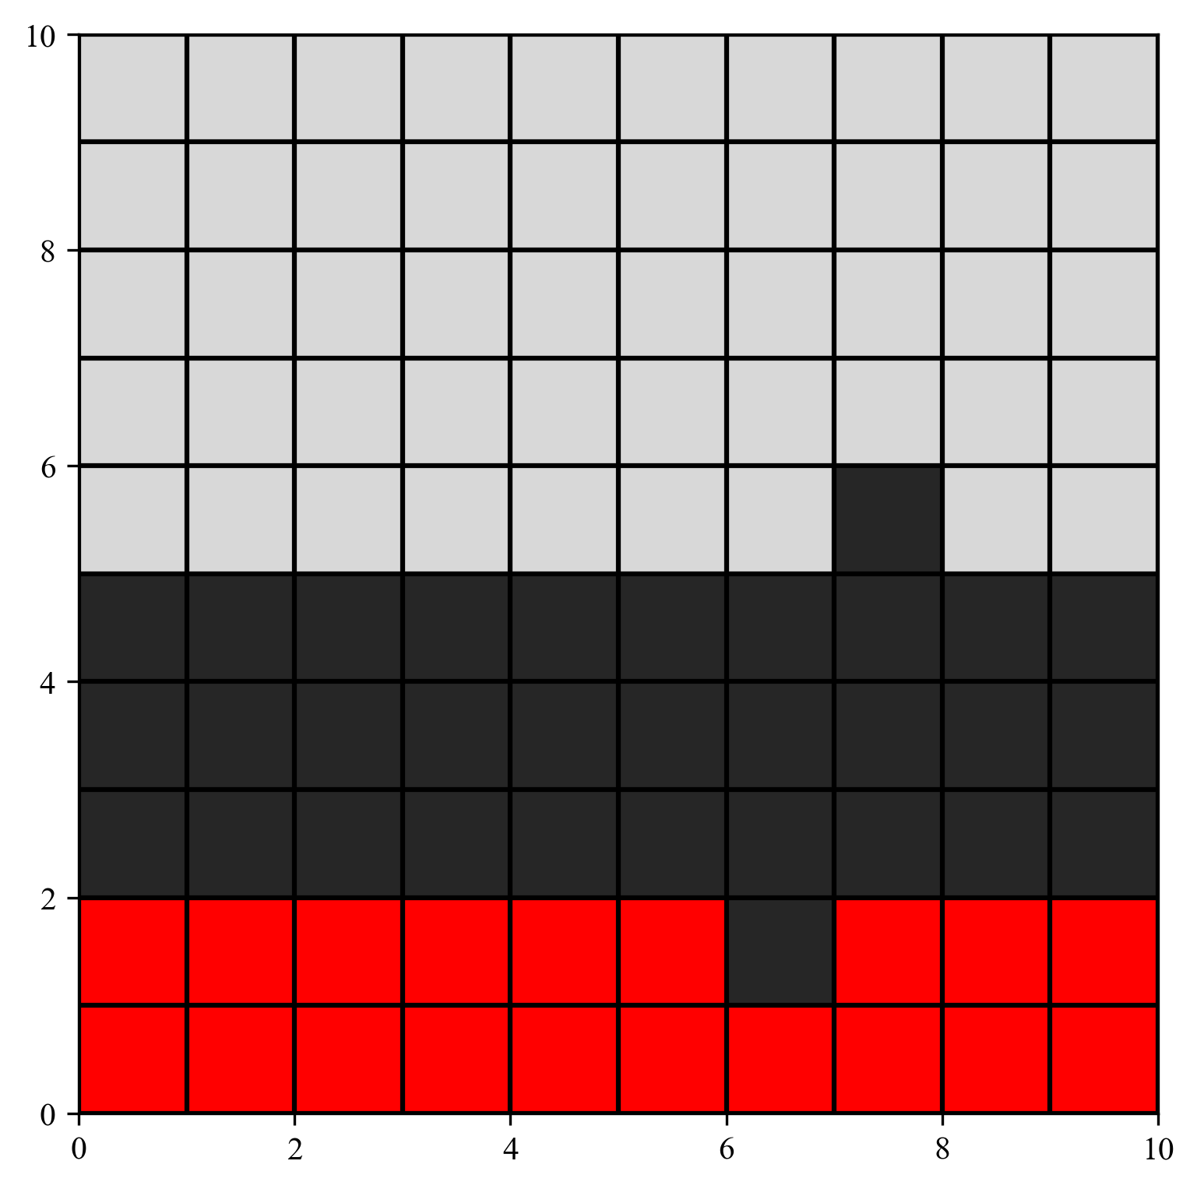
Rasterization
GitHub: https://github.com/jerryweihuajing/Post-Processing

Slide 13

Rasterization
GitHub: https://github.com/jerryweihuajing/Post-Processing

Slide 14
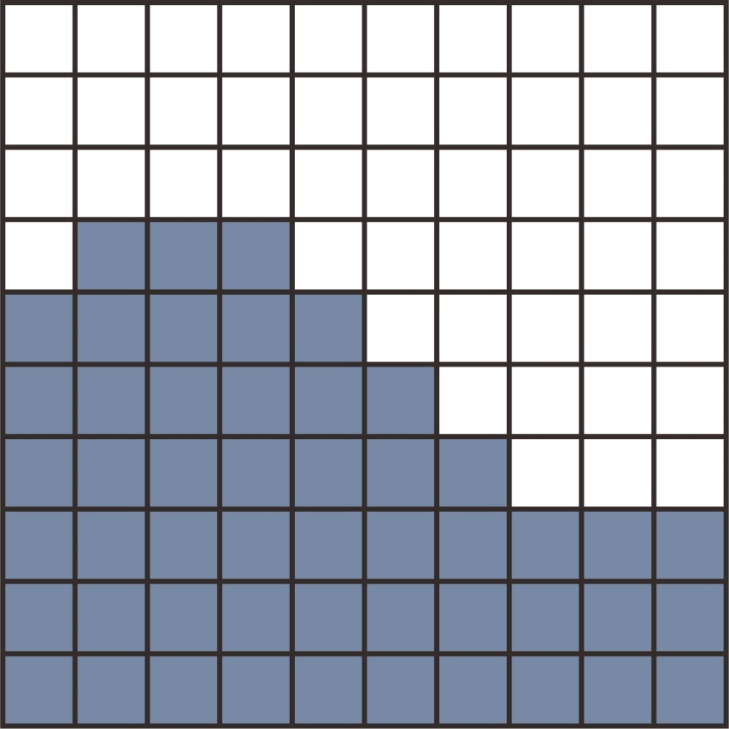
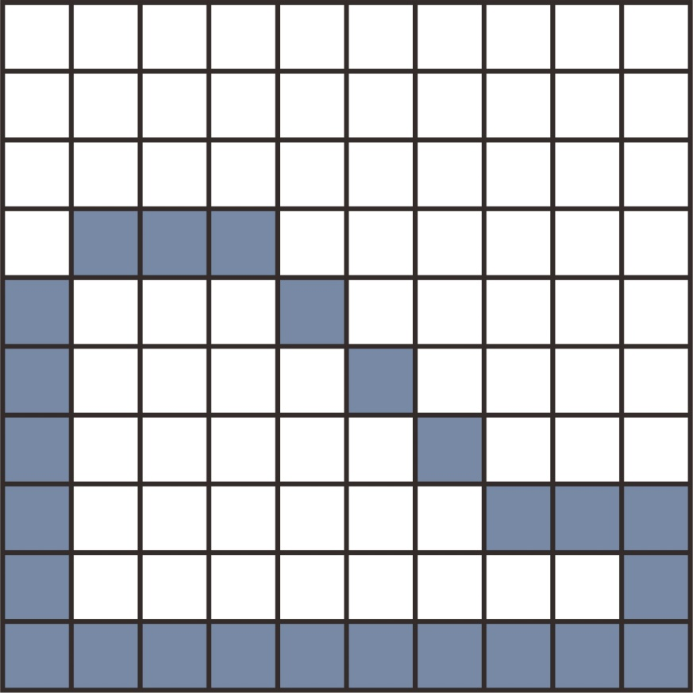
Boundary Extraction
GitHub: https://github.com/jerryweihuajing/Post-Processing

Slide 15
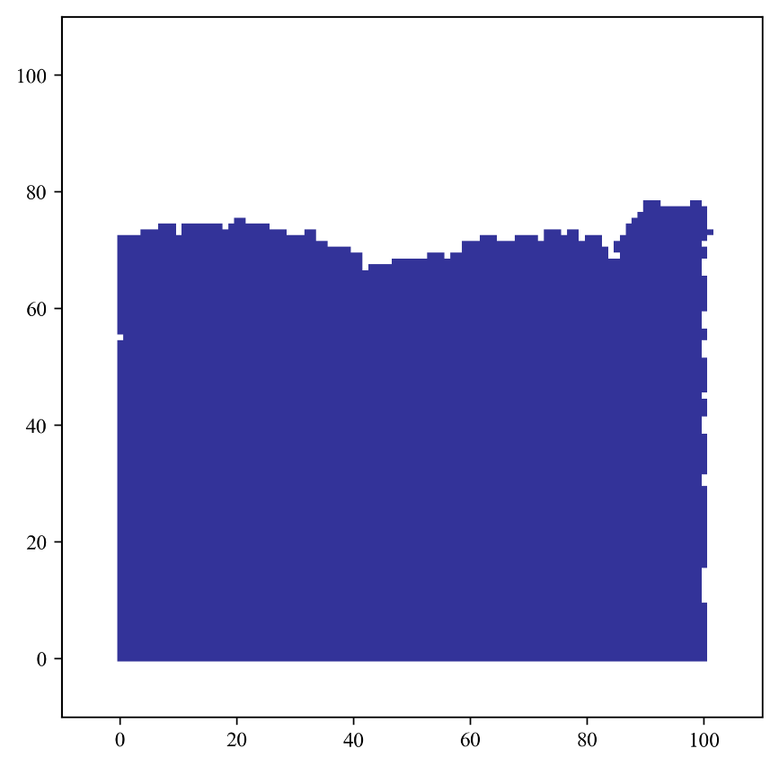
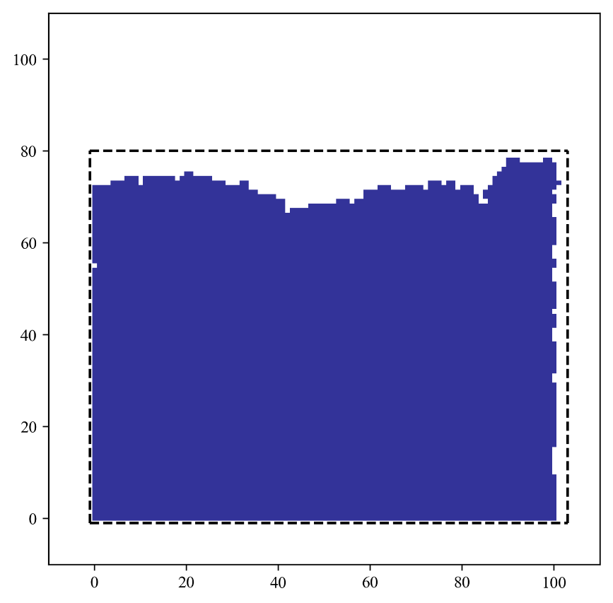
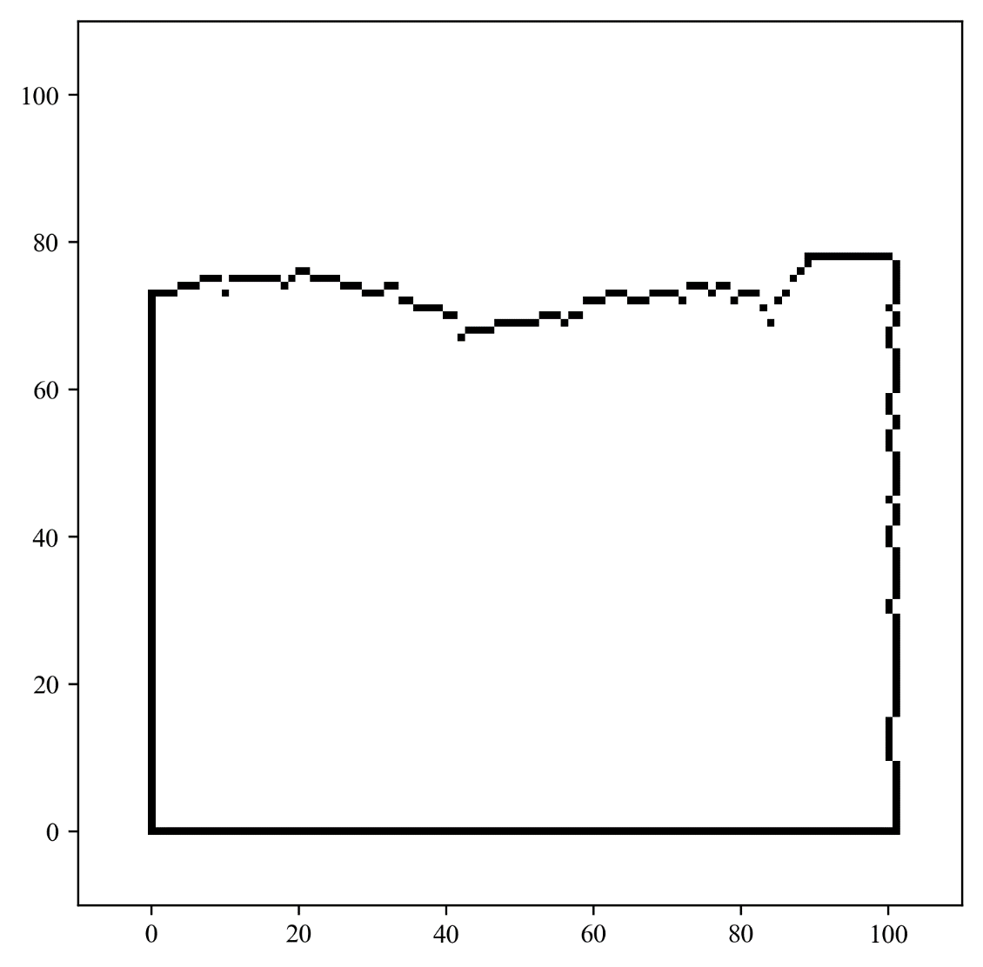
Boundary Extraction
GitHub: https://github.com/jerryweihuajing/Post-Processing

Slide 16
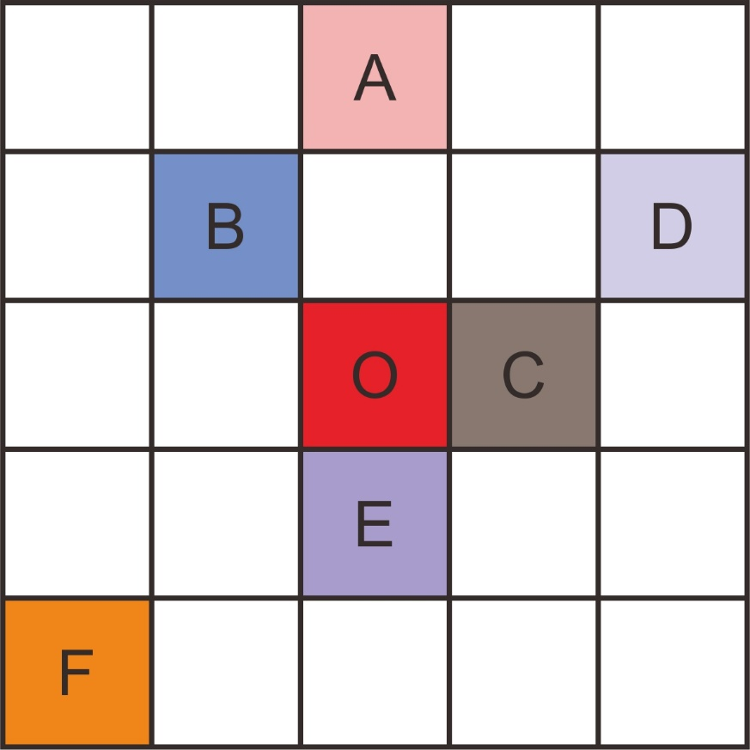
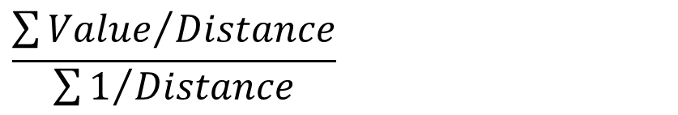
Spatial Interpolation
Inverse Distance Weighting:
$$\frac{\sum{{Value}/{Distance}}}{\sum{1/{Distance}}}$$
GitHub: https://github.com/jerryweihuajing/Post-Processing

Slide 17
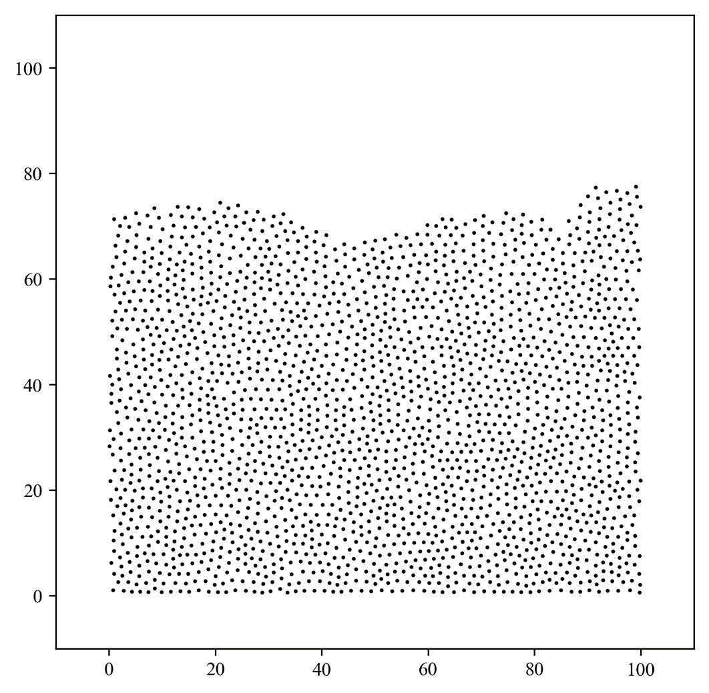
Spatial Interpolation
GitHub: https://github.com/jerryweihuajing/Post-Processing

Slide 18
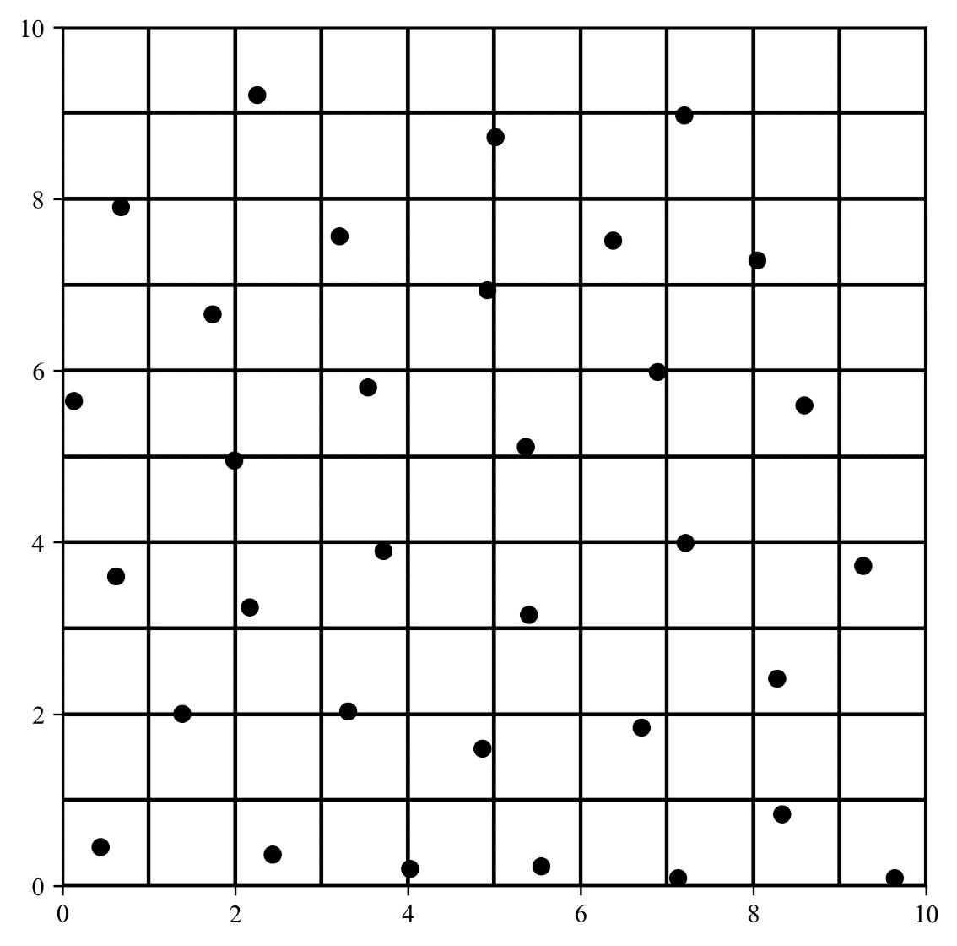
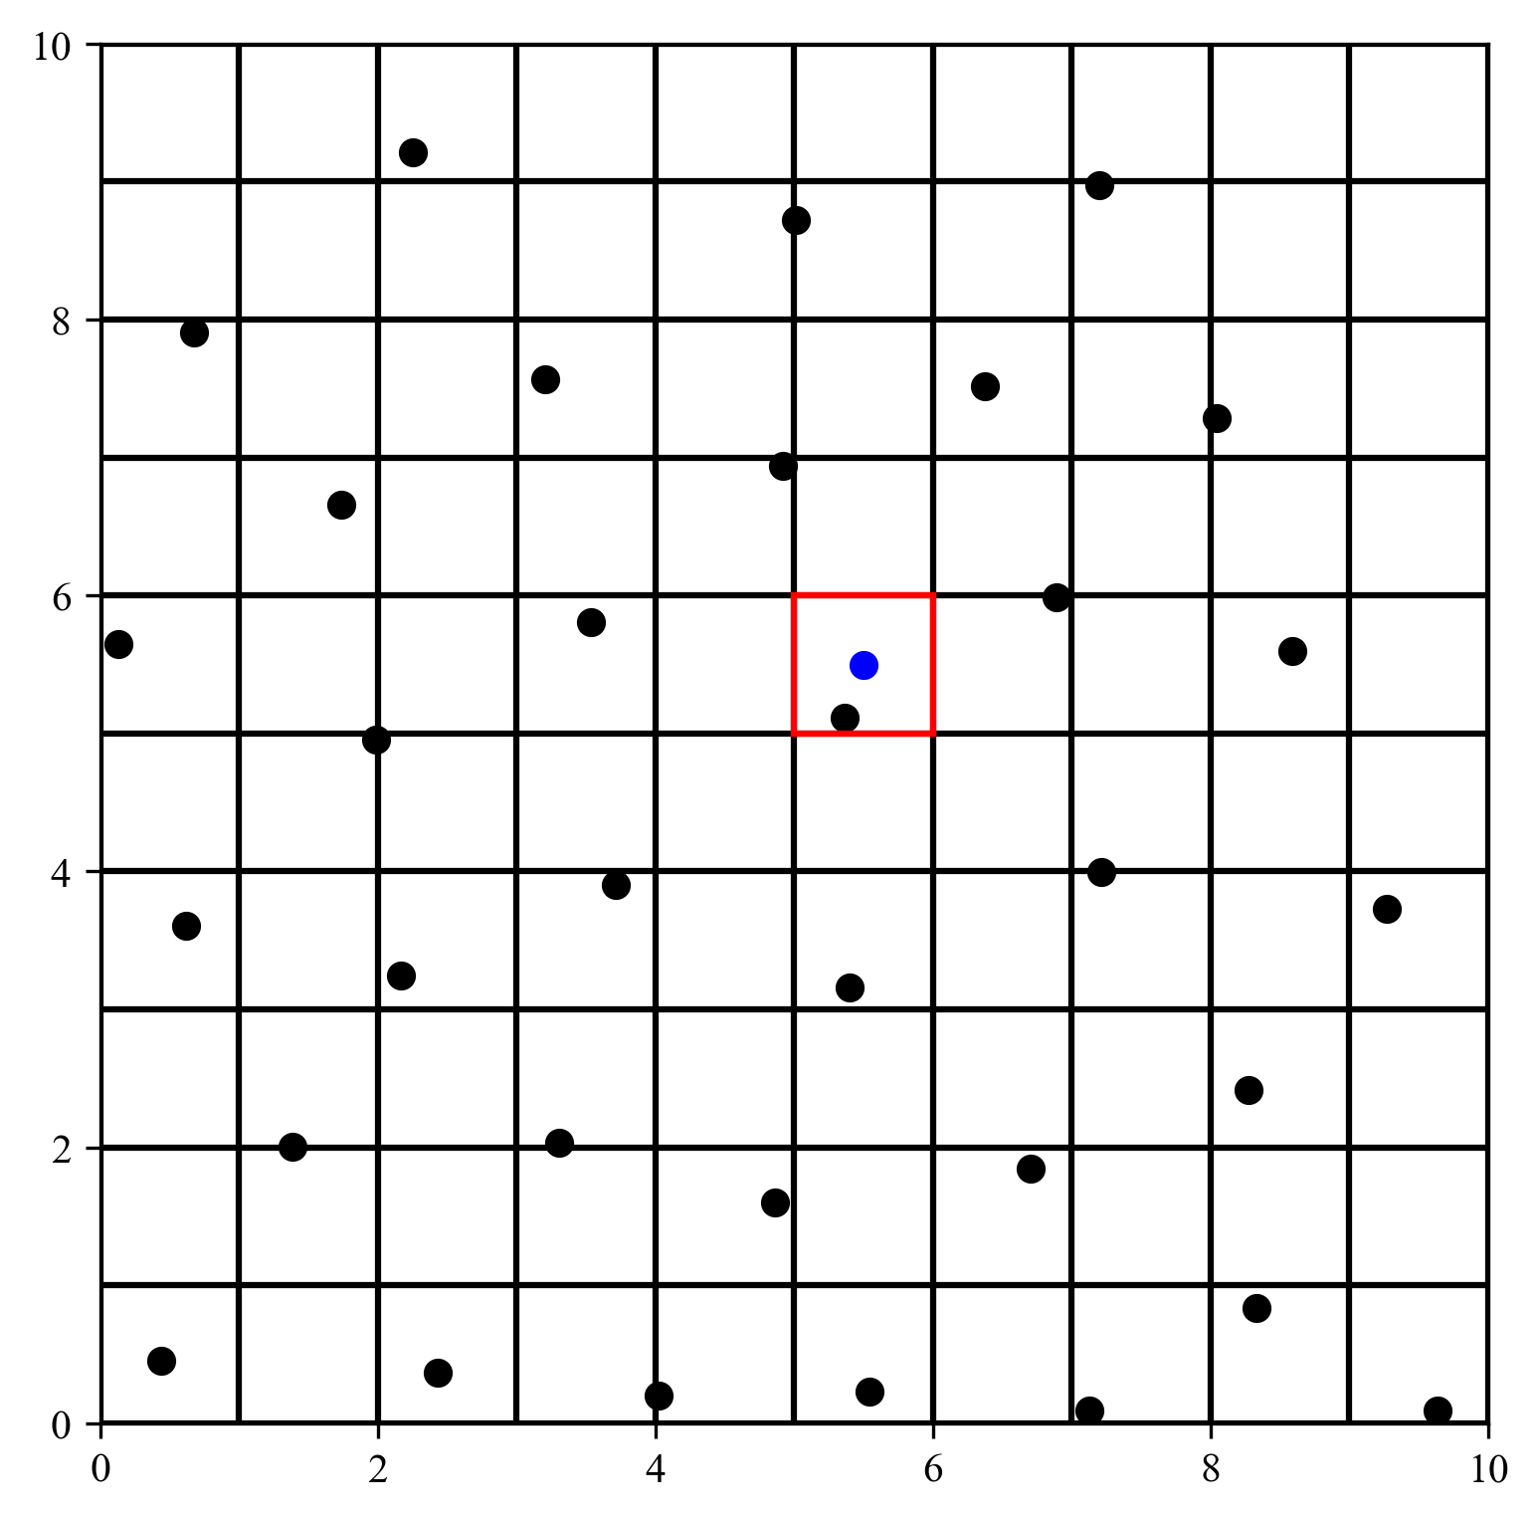
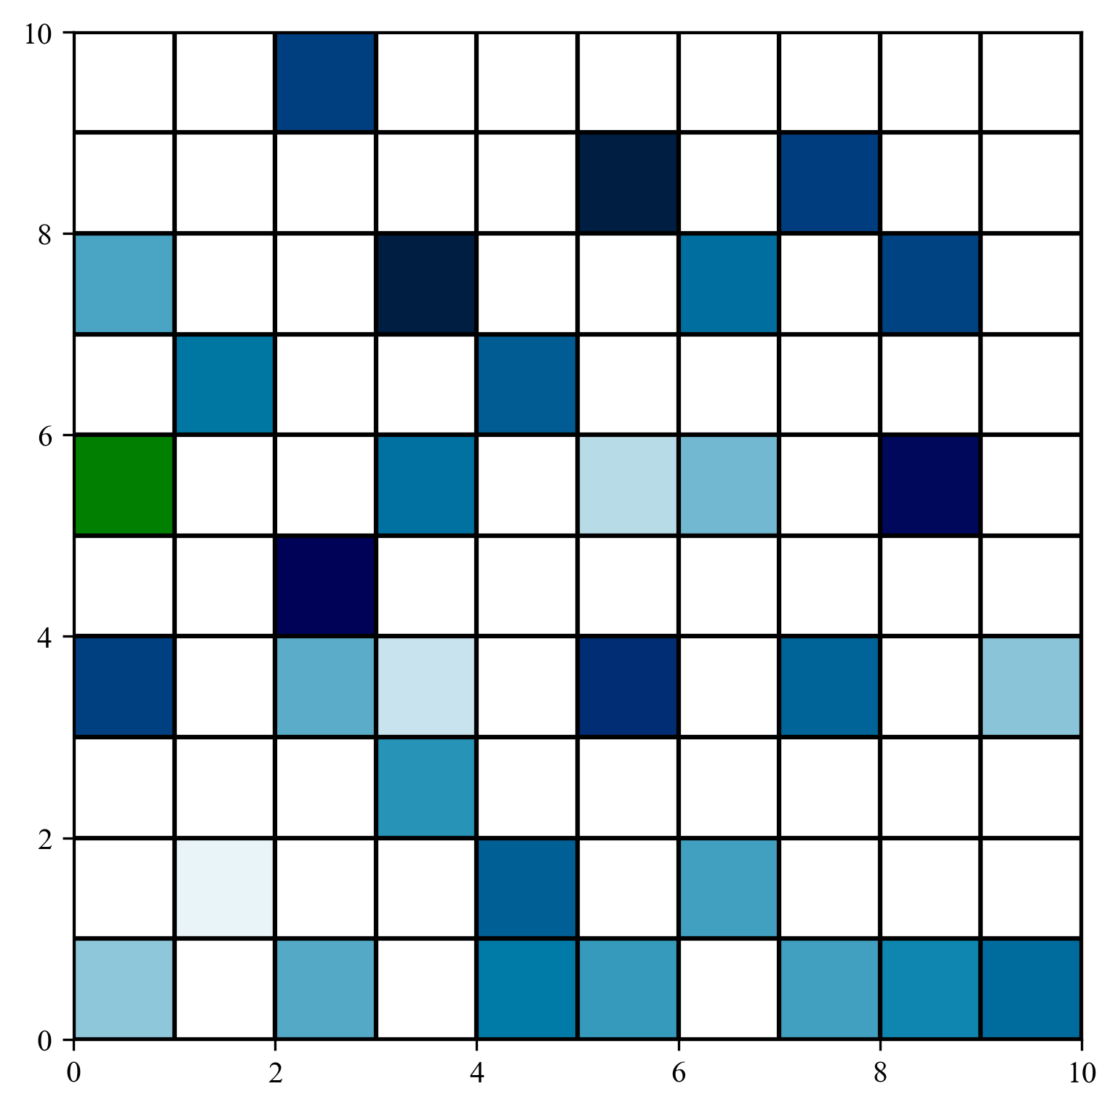
Spatial Interpolation
GitHub: https://github.com/jerryweihuajing/Post-Processing

Slide 19
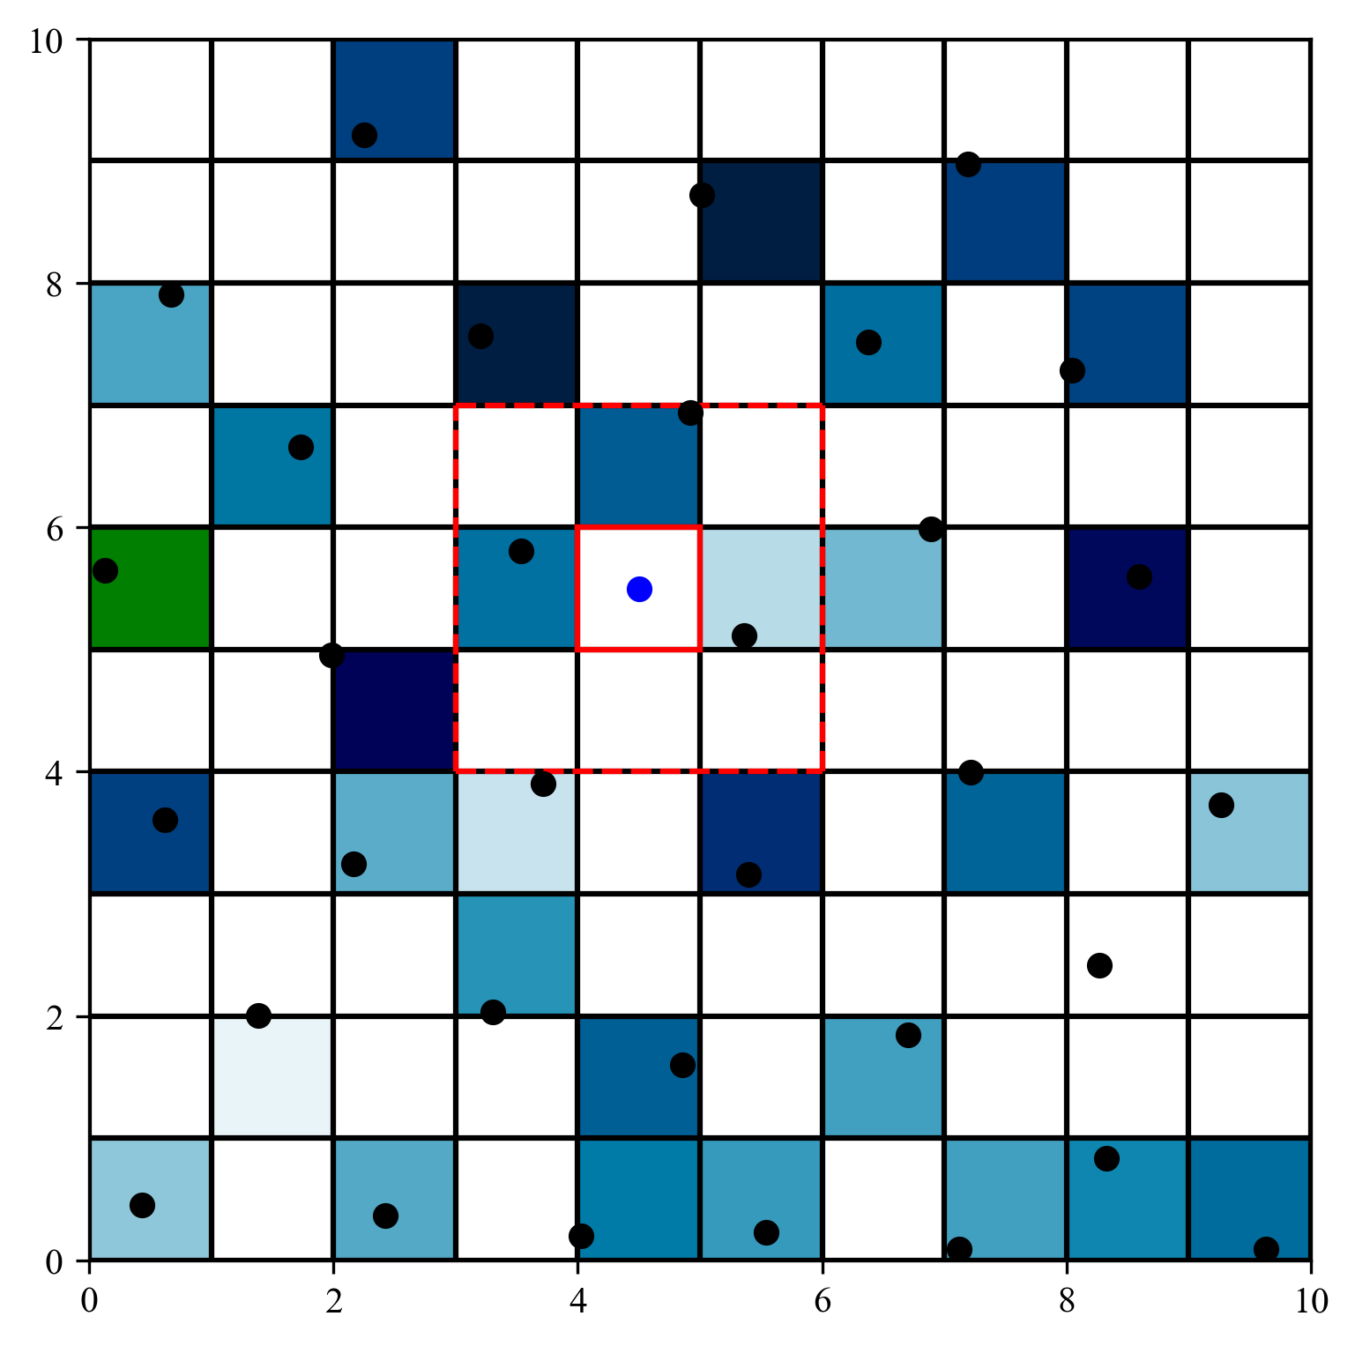
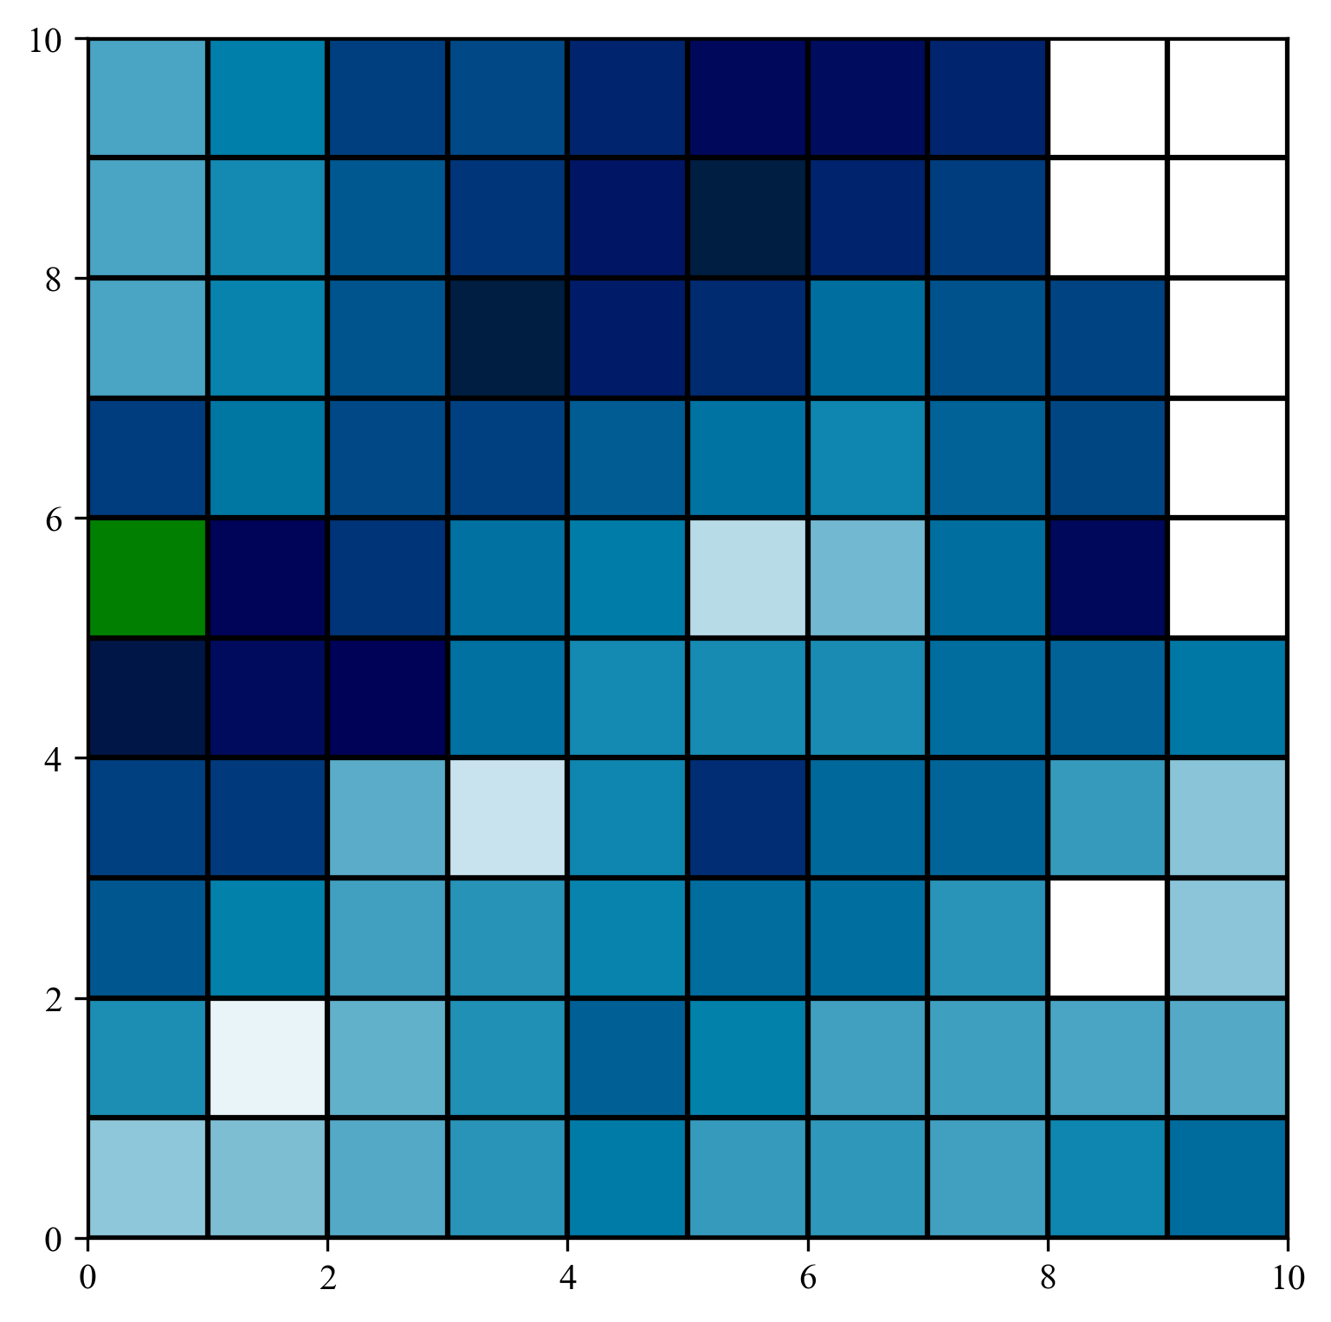
Spatial Interpolation
GitHub: https://github.com/jerryweihuajing/Post-Processing

Slide 20

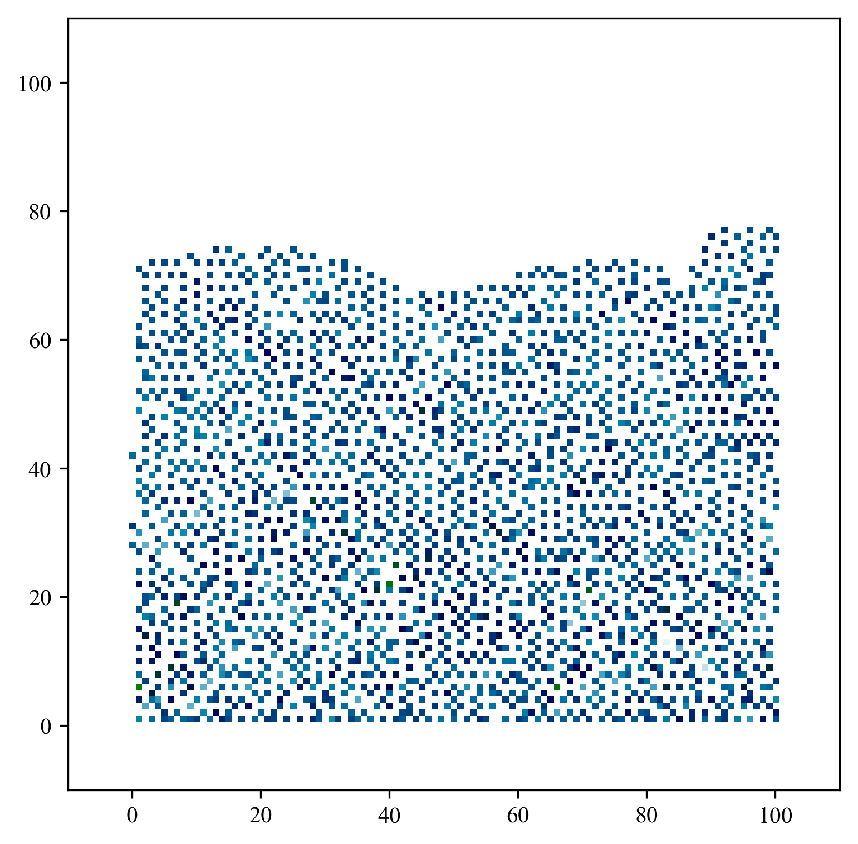
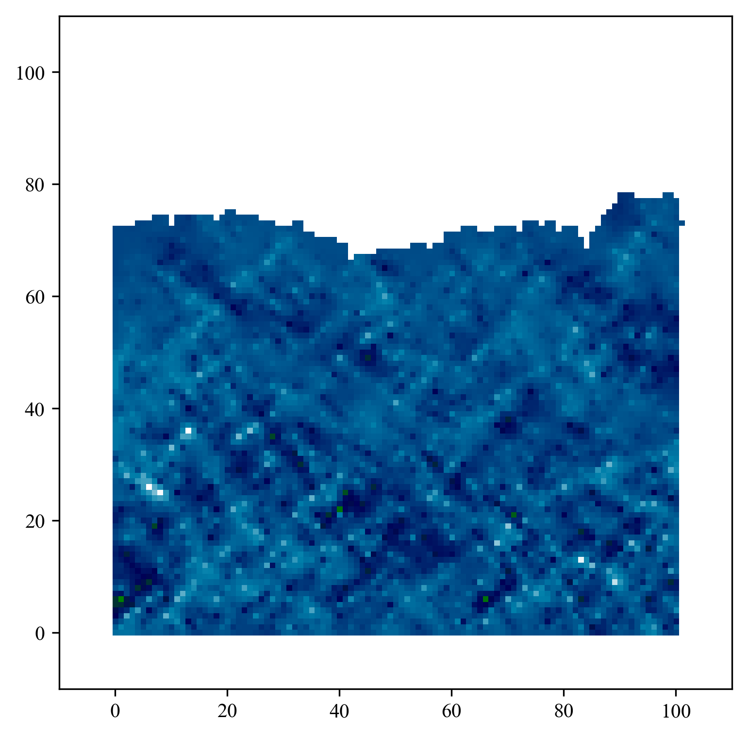
Spatial Interpolation
GitHub: https://github.com/jerryweihuajing/Post-Processing

Slide 21
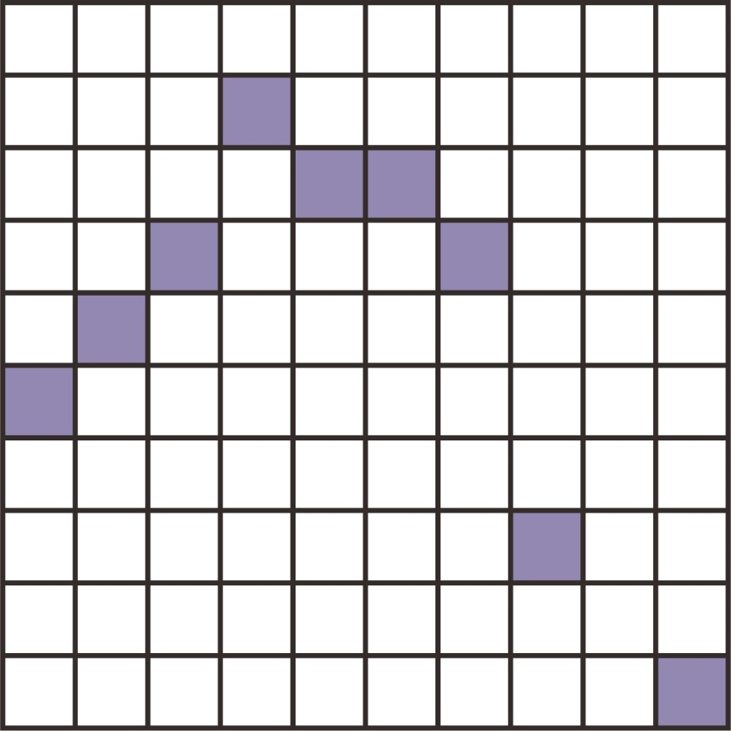
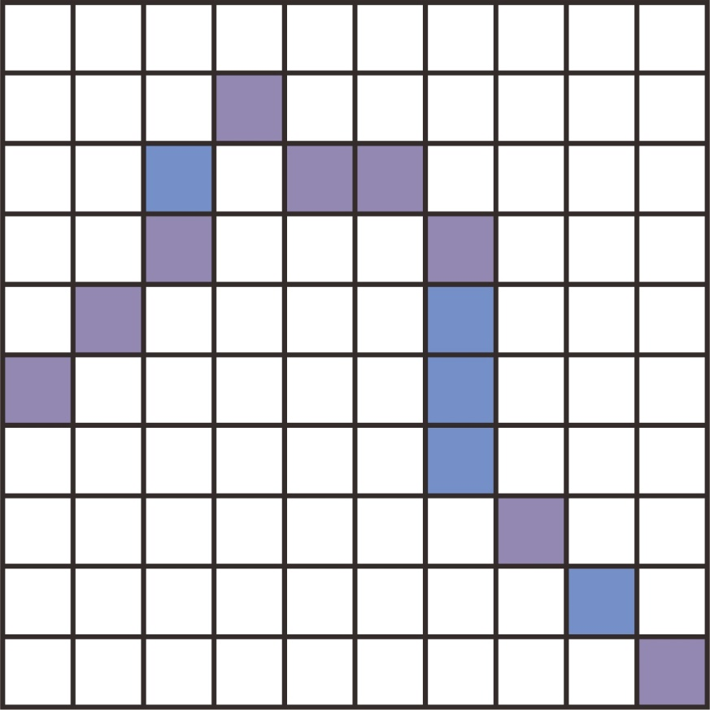
Erosion and Expansion
GitHub: https://github.com/jerryweihuajing/Post-Processing

Slide 22
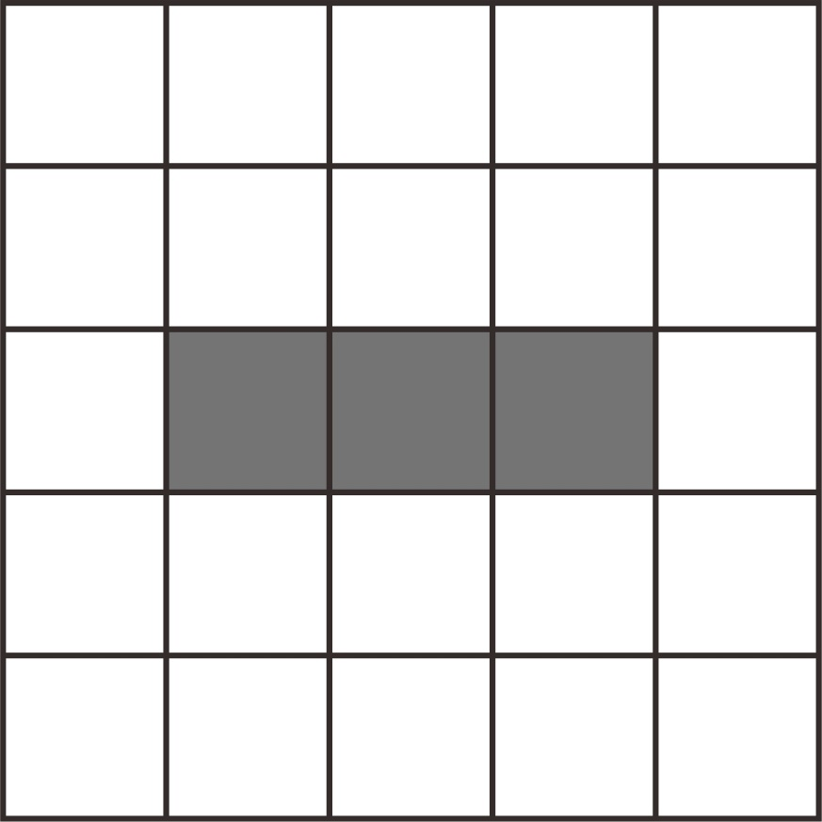
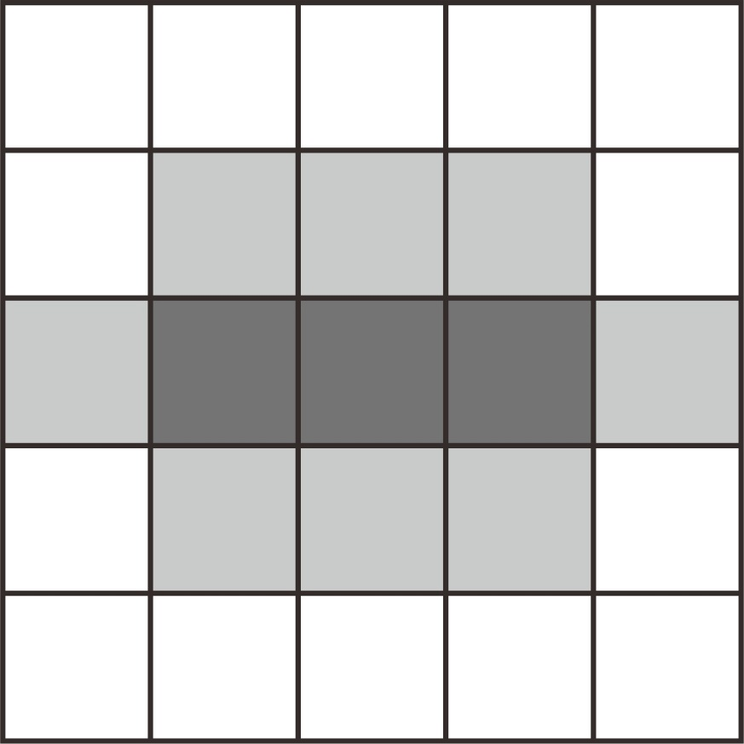
Erosion and Expansion
GitHub: https://github.com/jerryweihuajing/Post-Processing

Slide 23

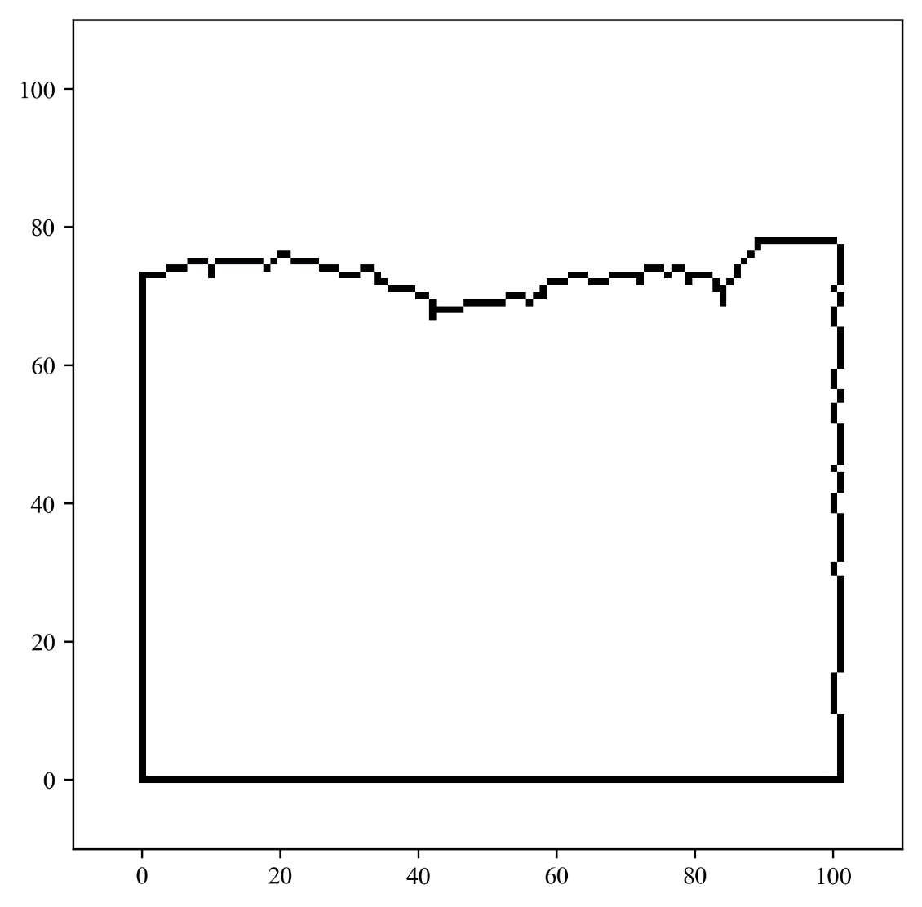
Erosion and Expansion
GitHub: https://github.com/jerryweihuajing/Post-Processing

Slide 24


Erosion and Expansion
Join the boundary to make it complete.
GitHub: https://github.com/jerryweihuajing/Post-Processing

Slide 25
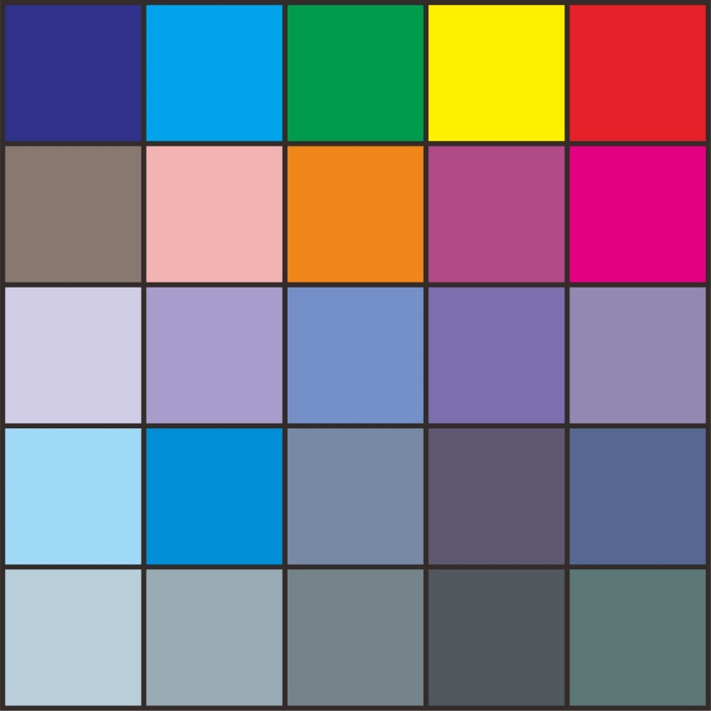
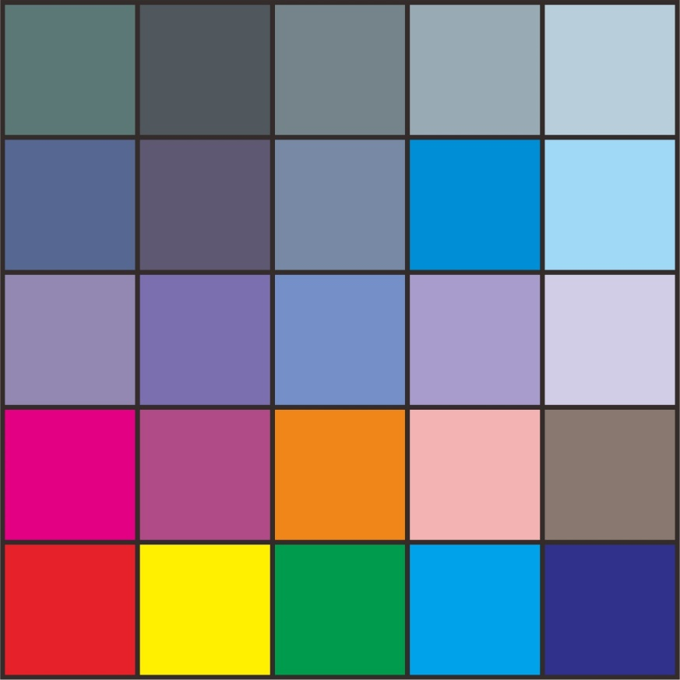
Gaussian Filtering
Window from Image
Gaussian Kernel
GitHub: https://github.com/jerryweihuajing/Post-Processing

Slide 26


Gaussian Filtering
Highlight consecutive signal and suppress spike.
GitHub: https://github.com/jerryweihuajing/Post-Processing

Slide 27
Content
Background
Algorithm
Experiment
Discussion
Conclusion

Slide 28
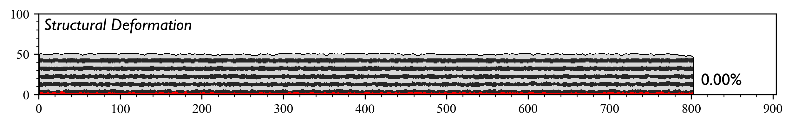
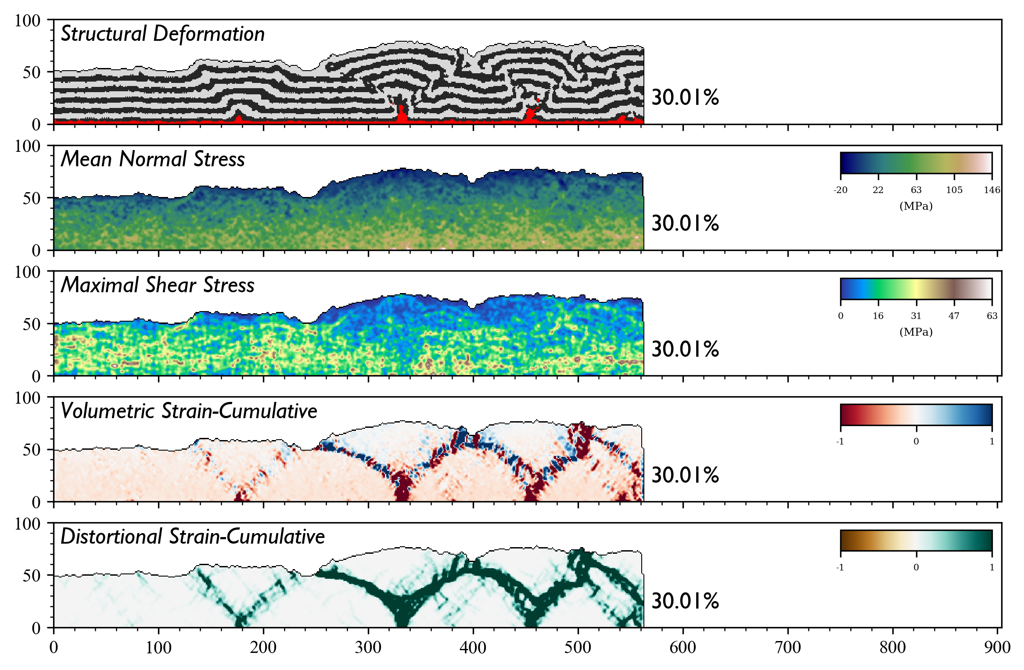
Base

Slide 29
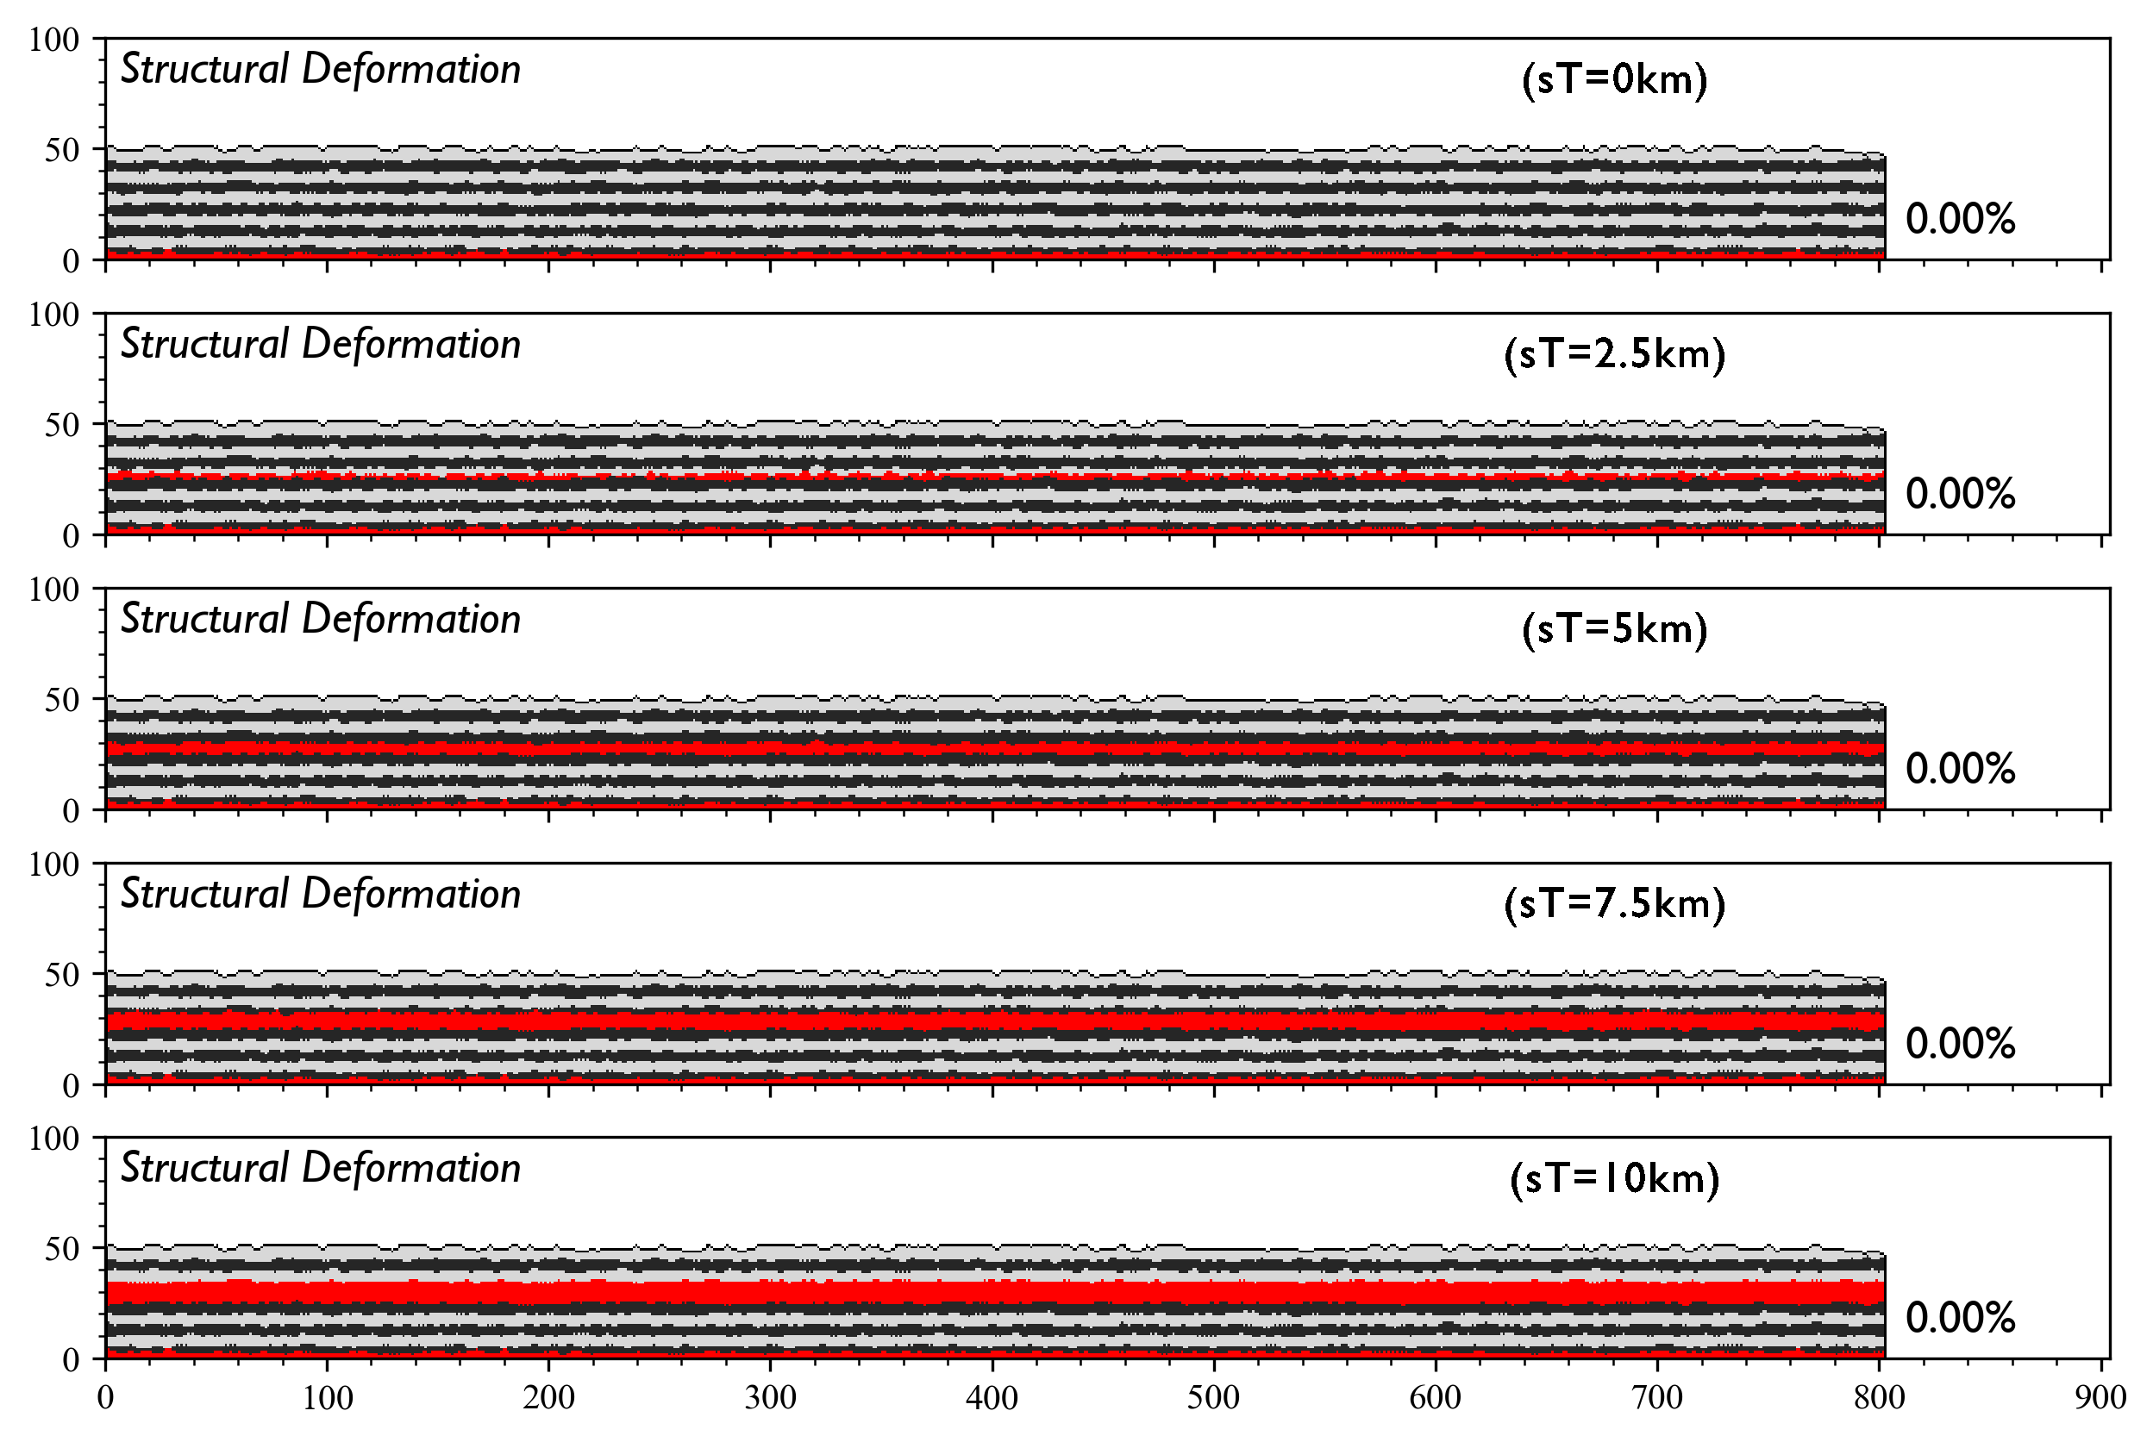
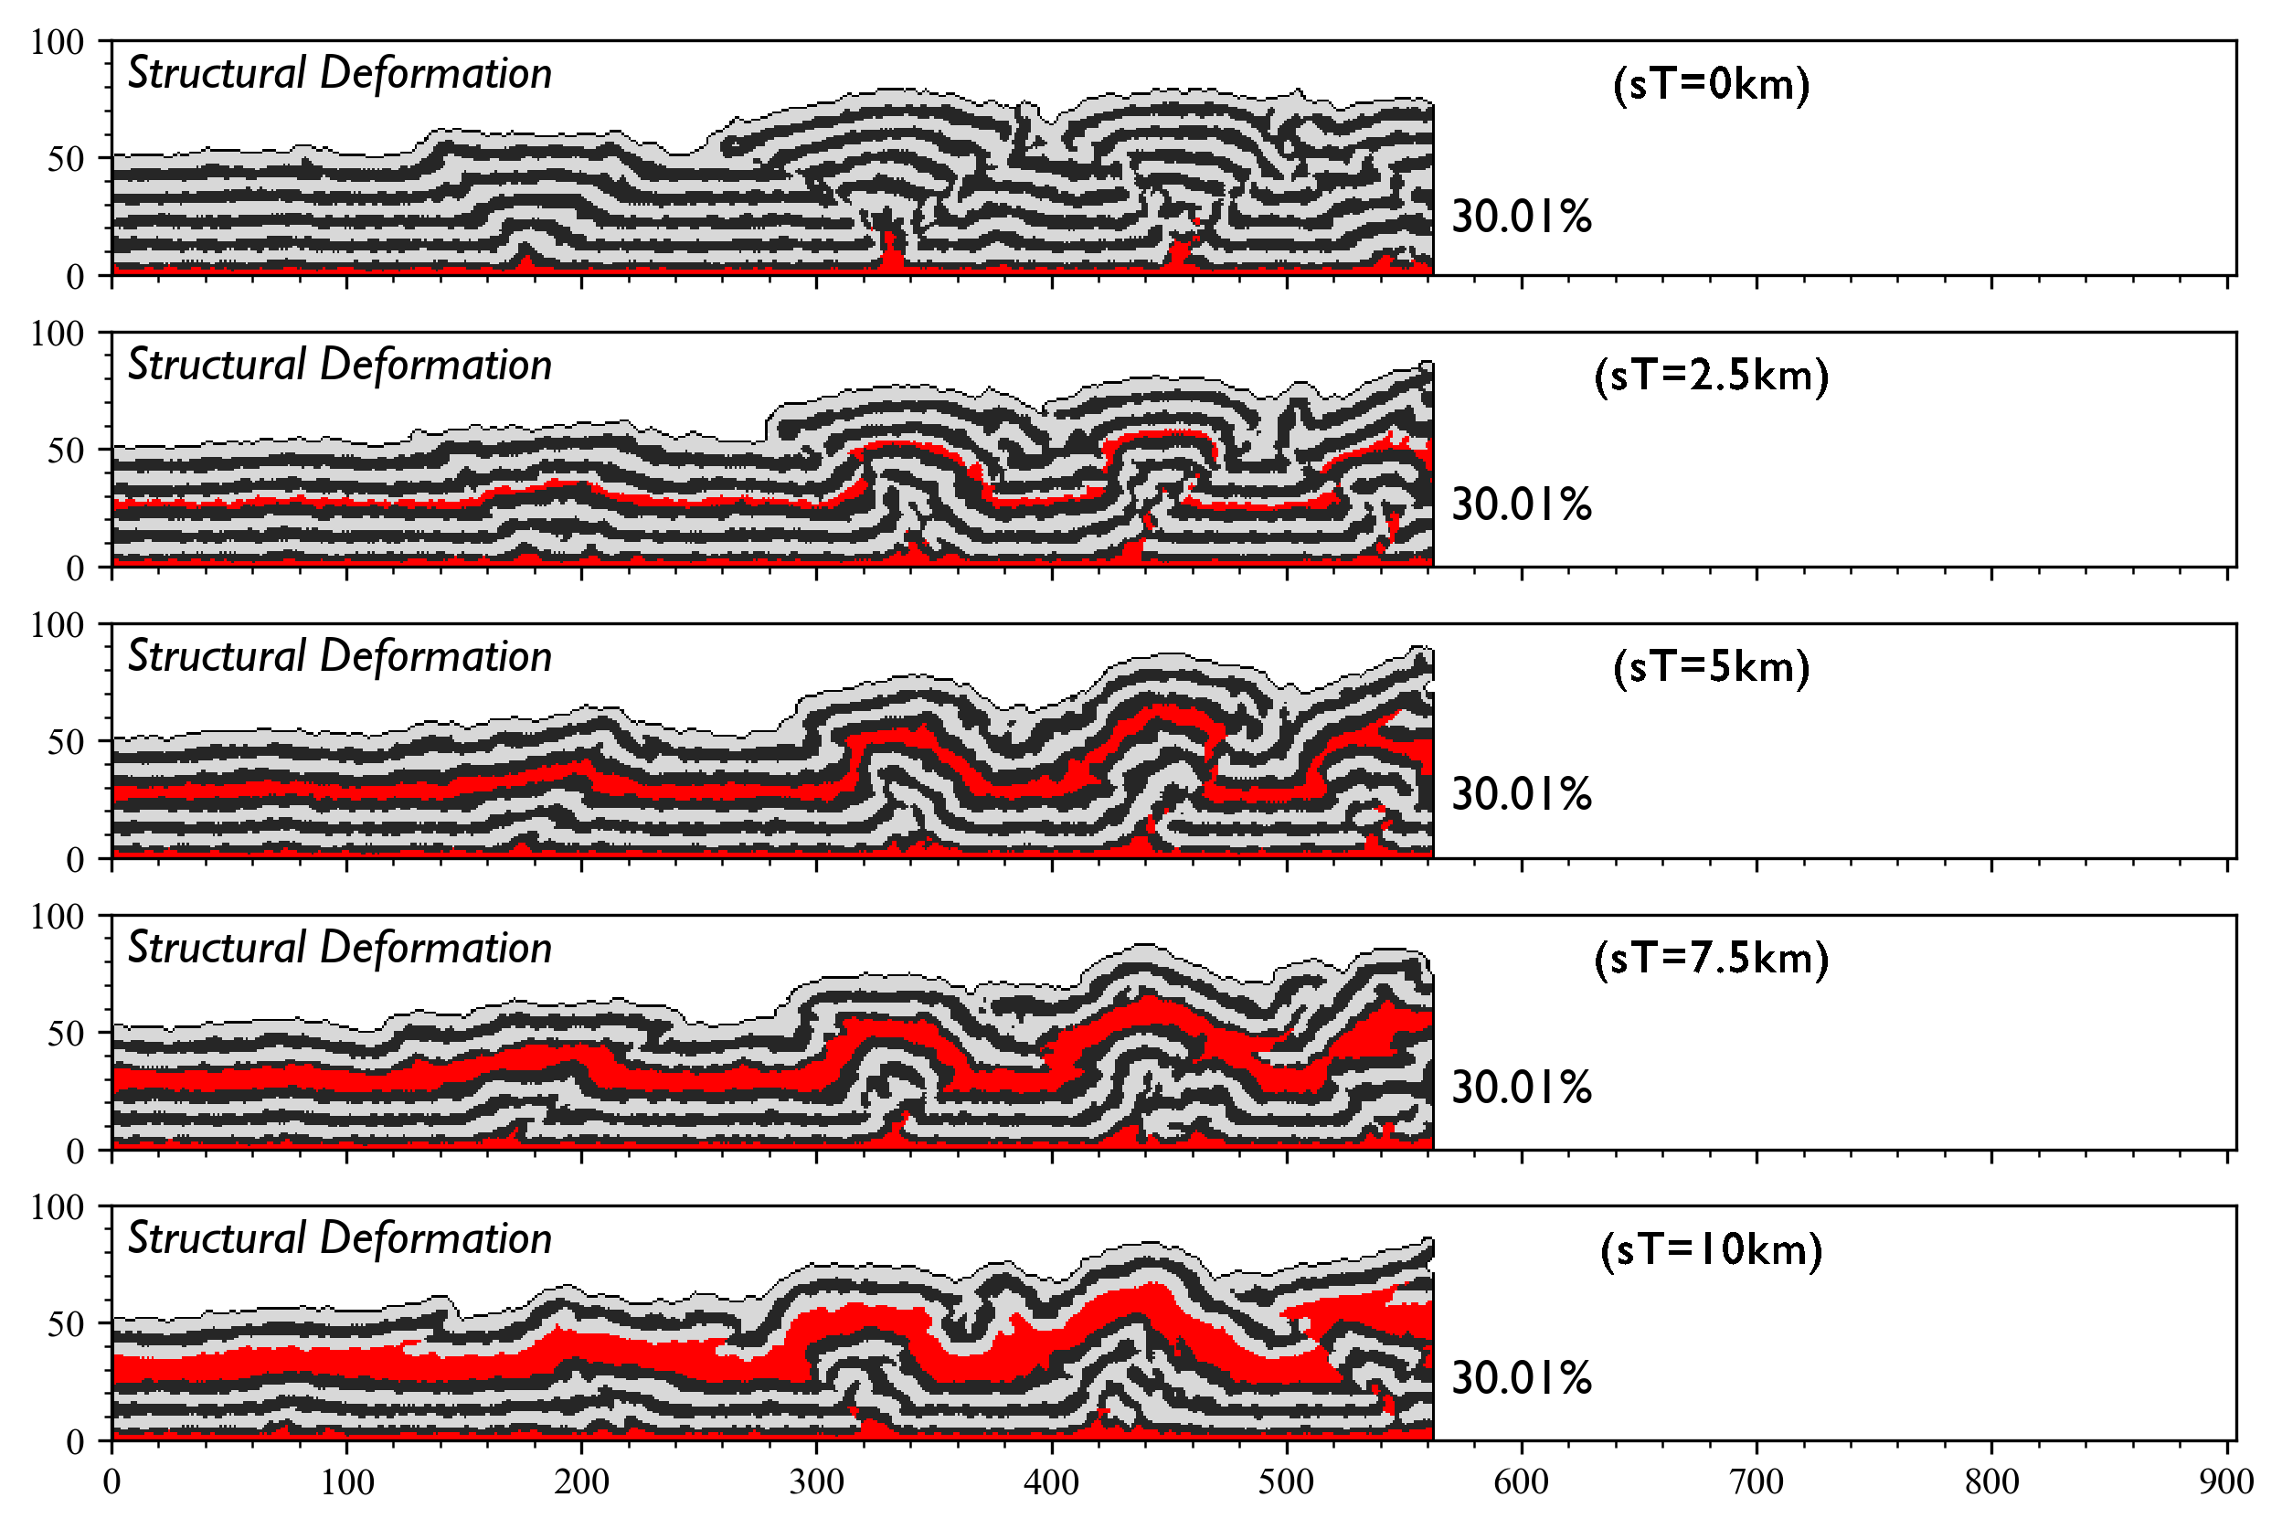
Salt Thickness

Slide 30
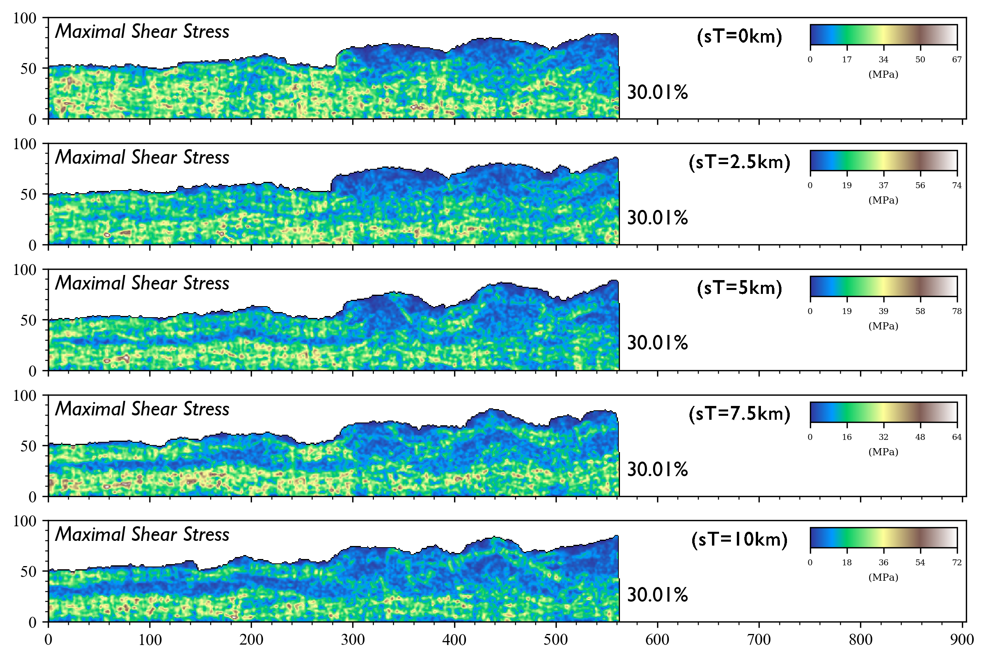
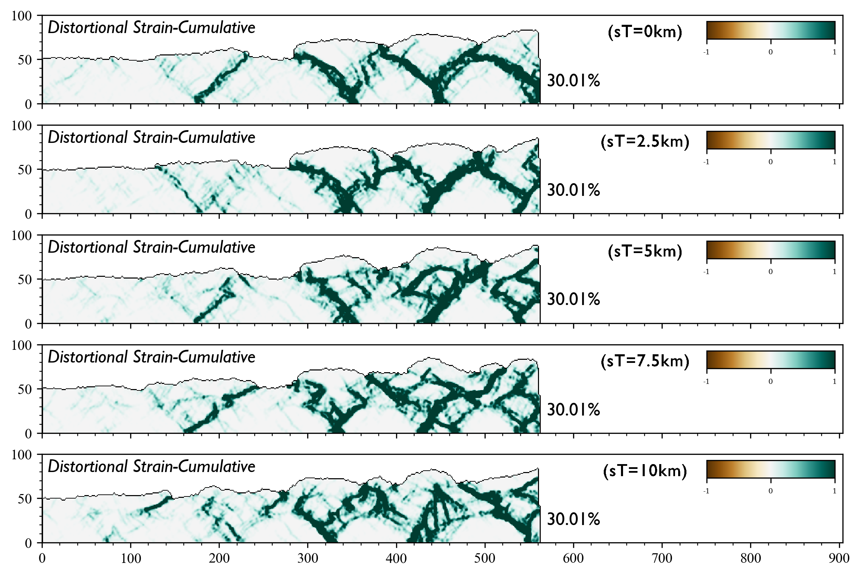
Salt Thickness

Slide 31
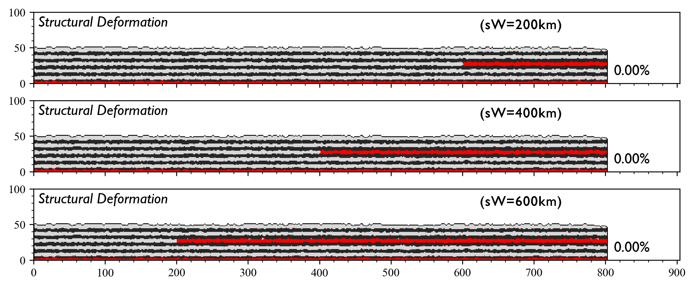
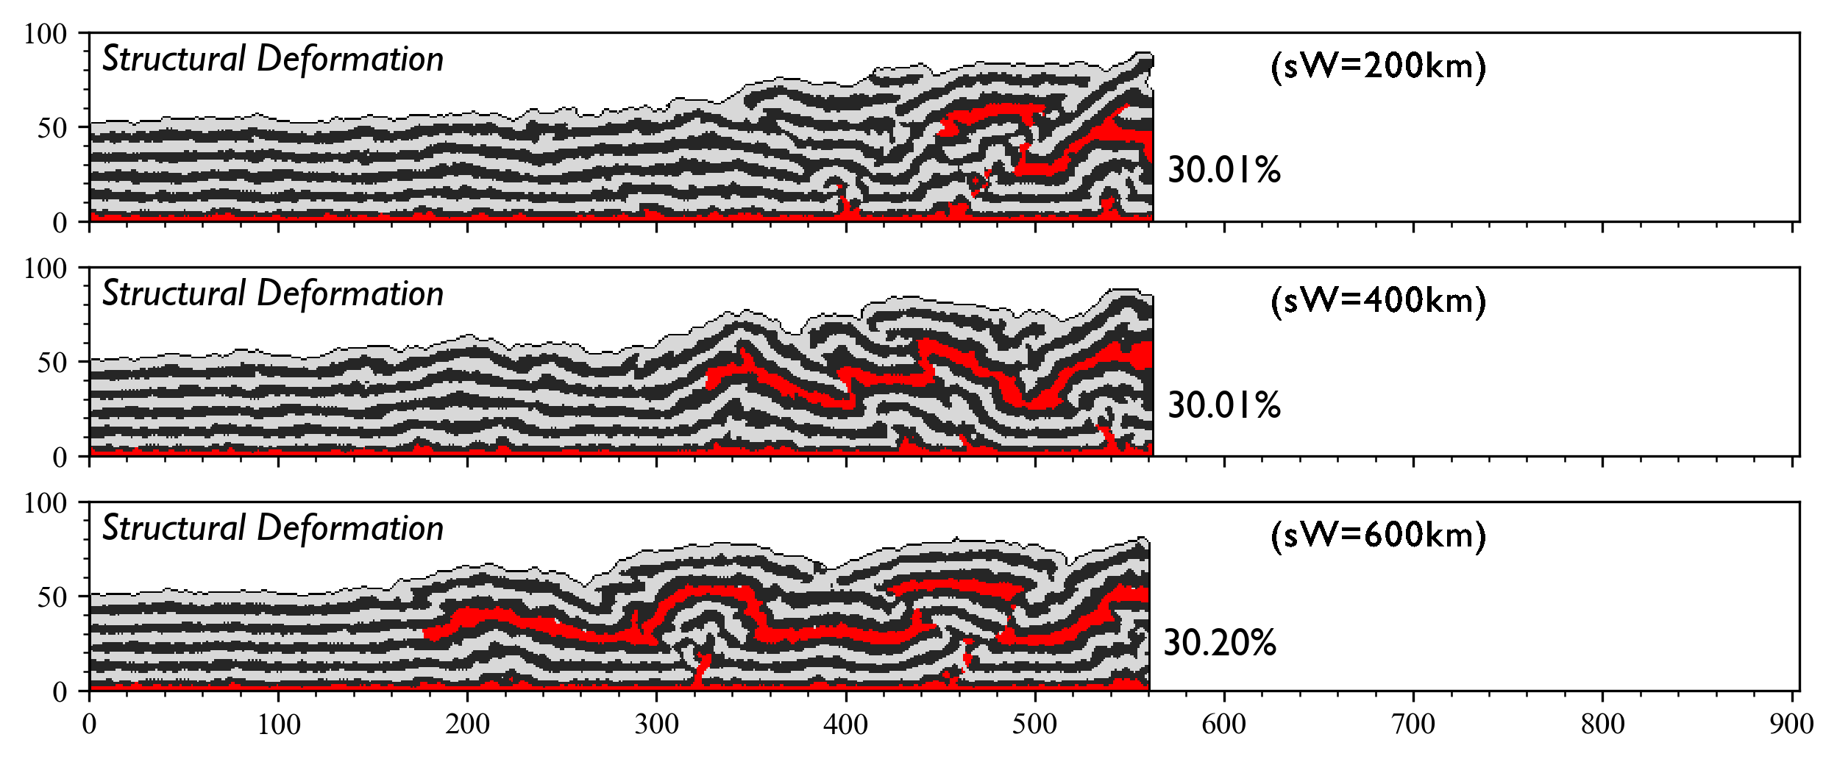
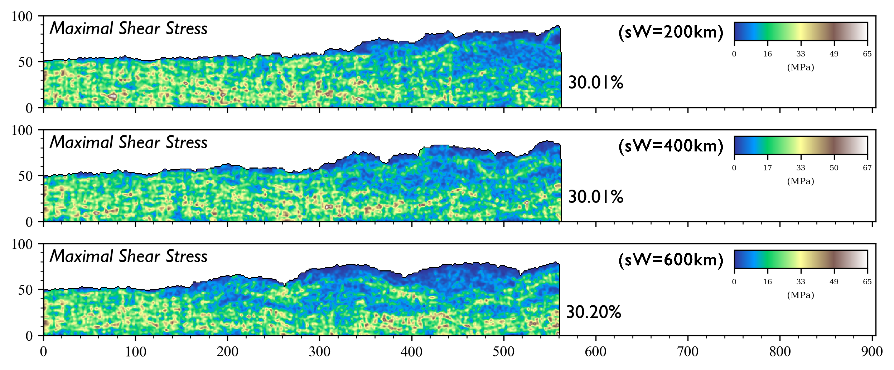
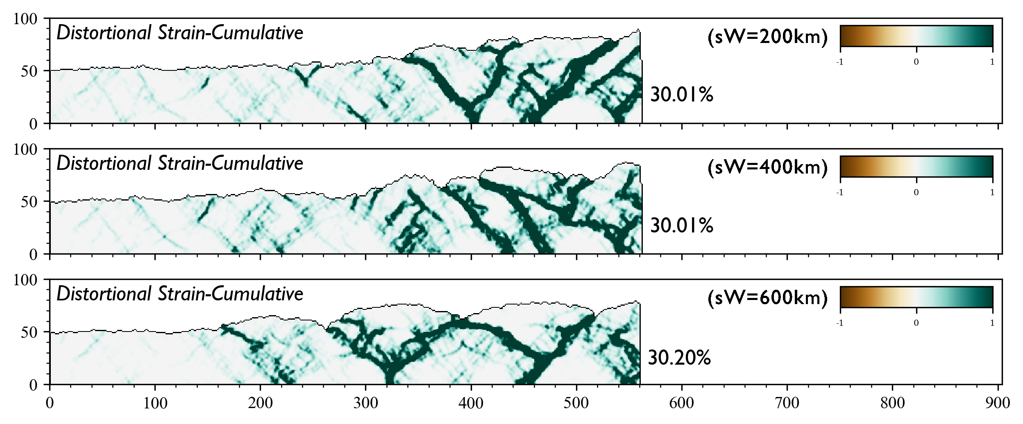
Salt Width

Slide 32
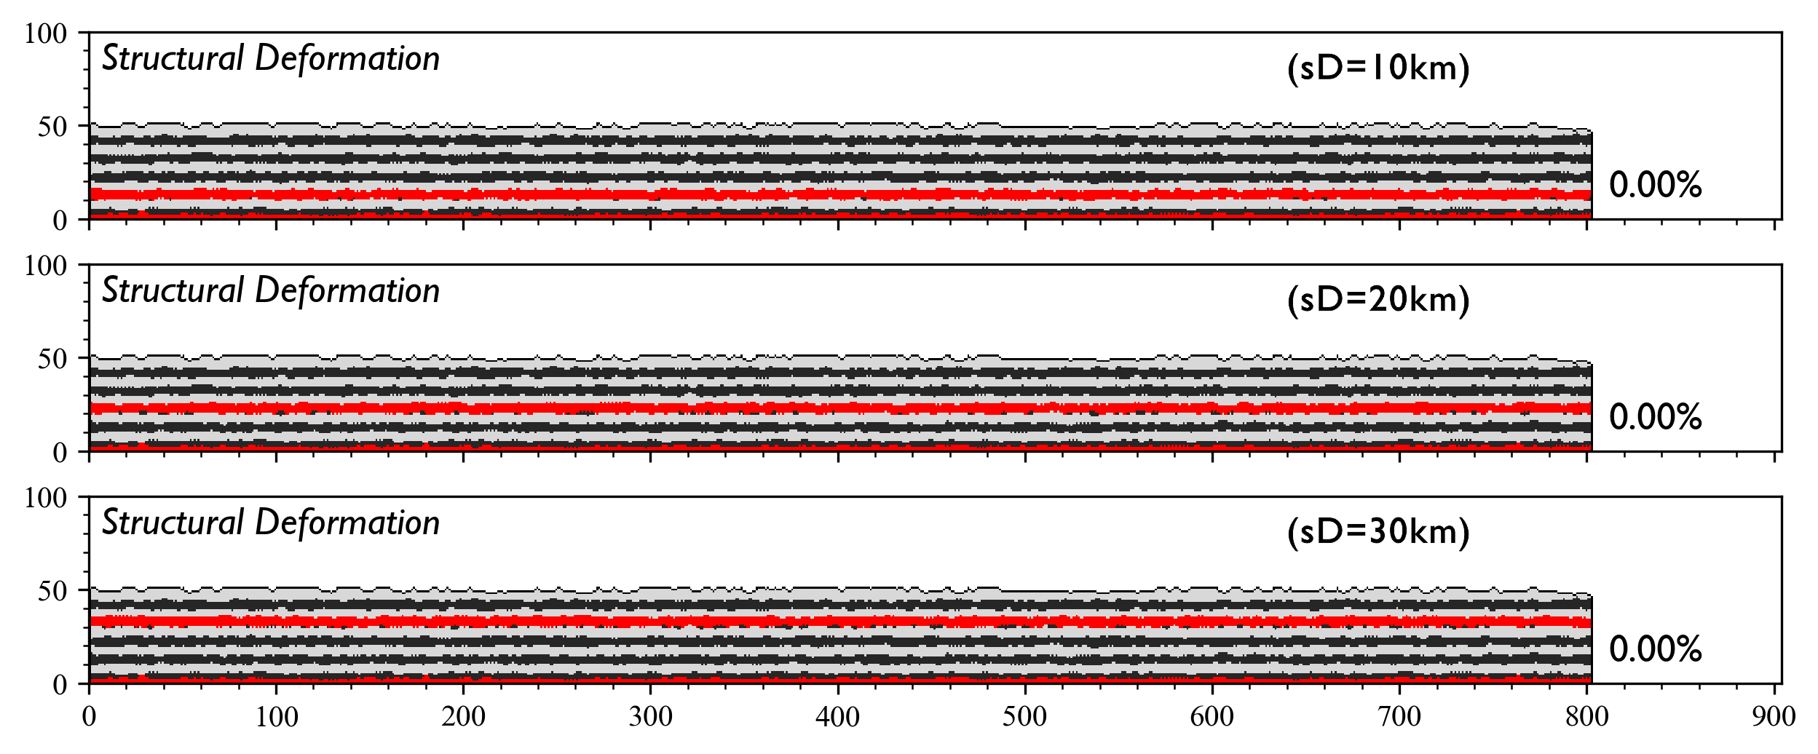
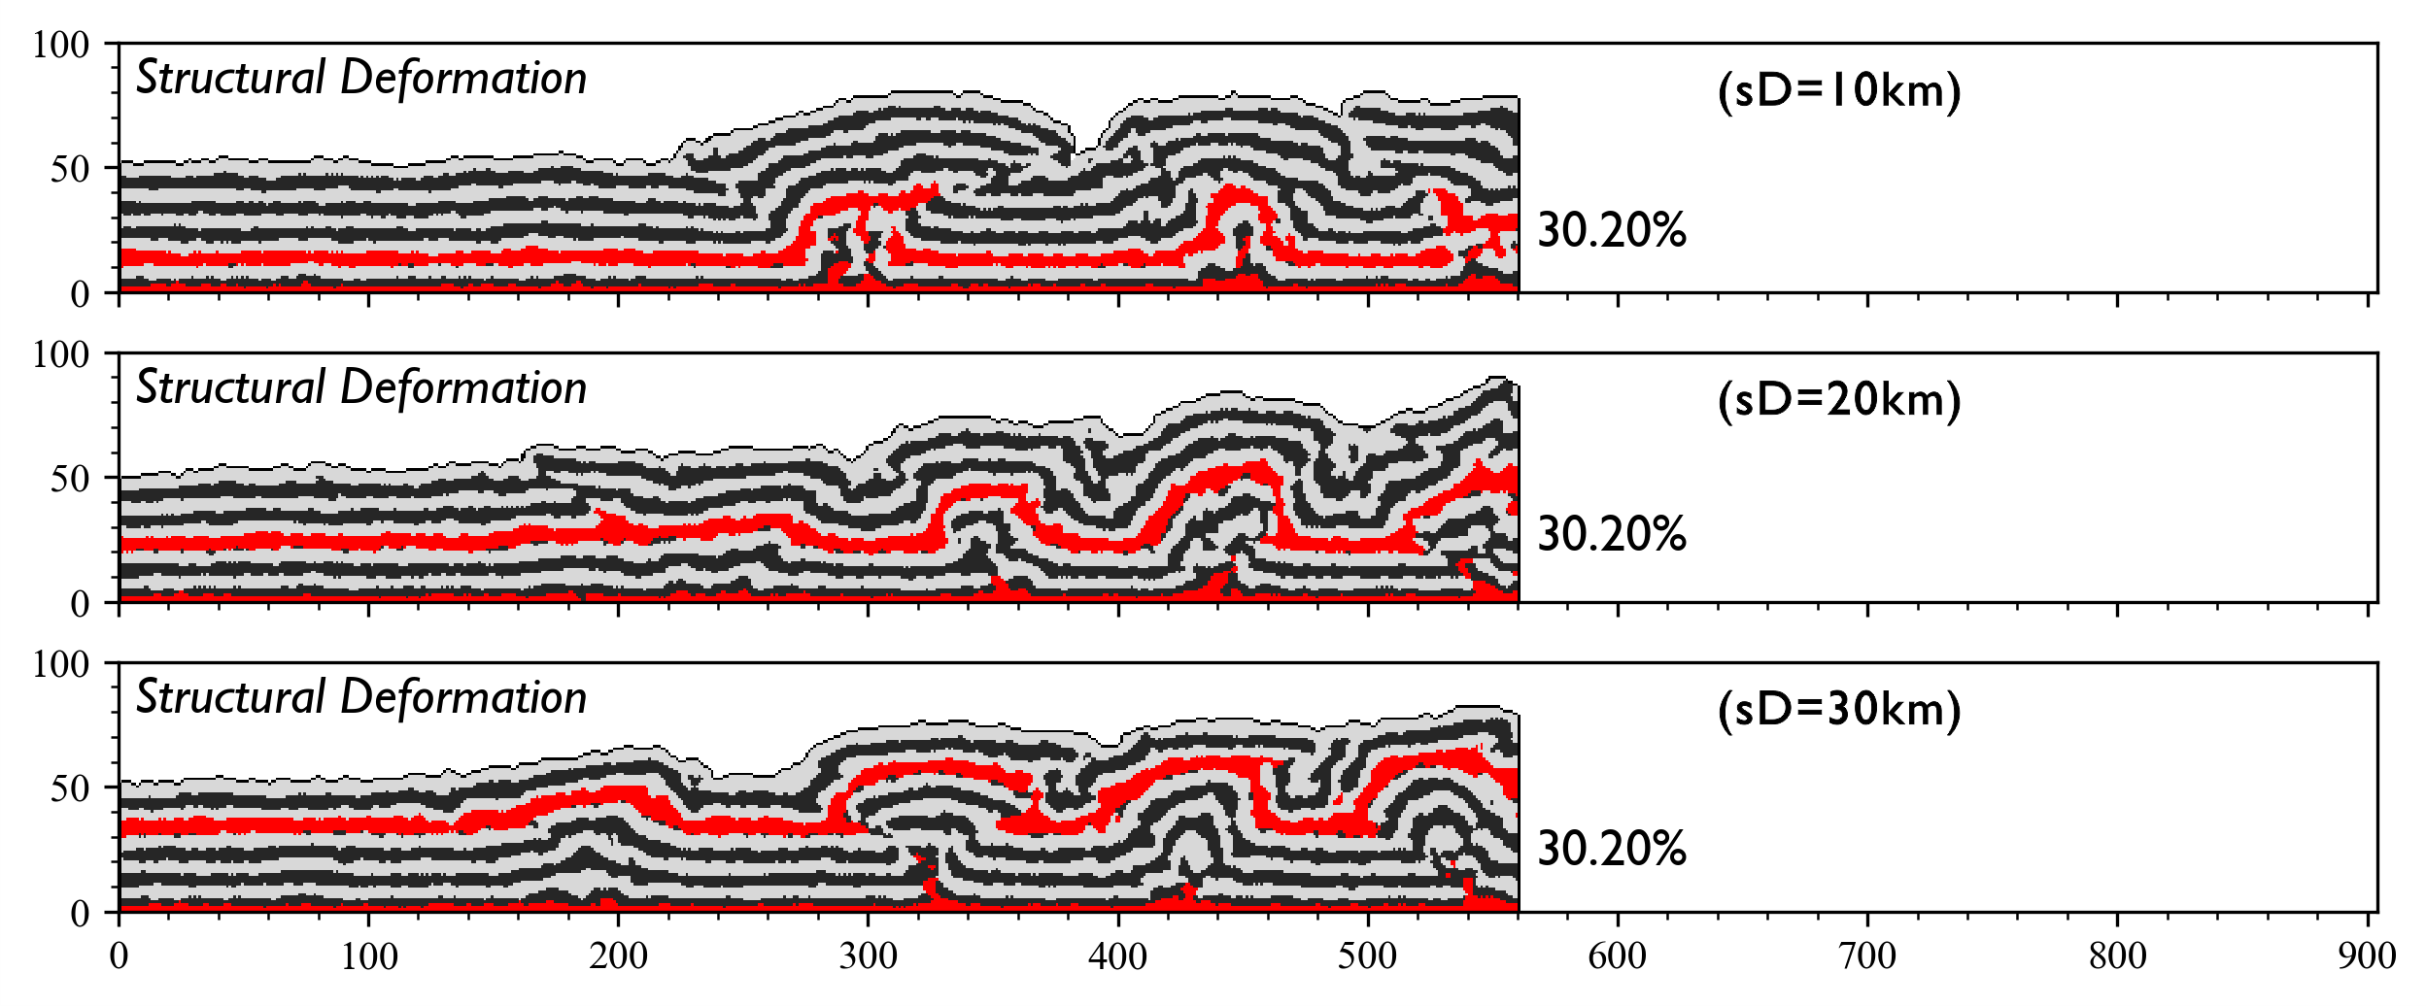
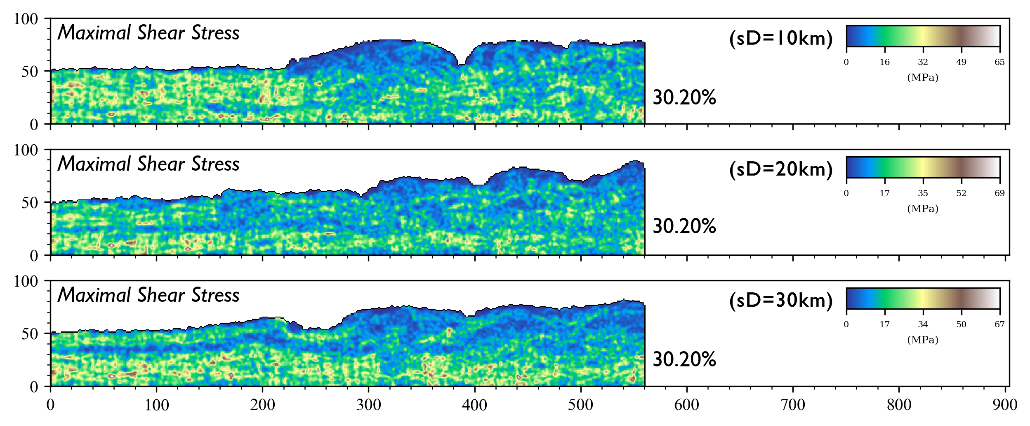
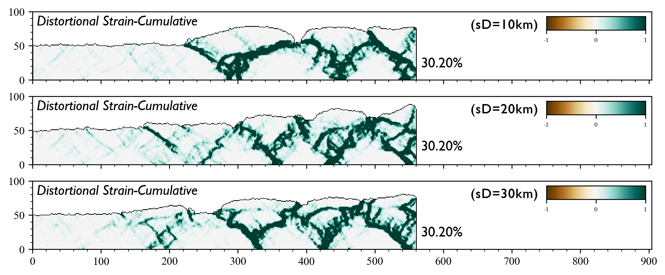
Salt Depth

Slide 33
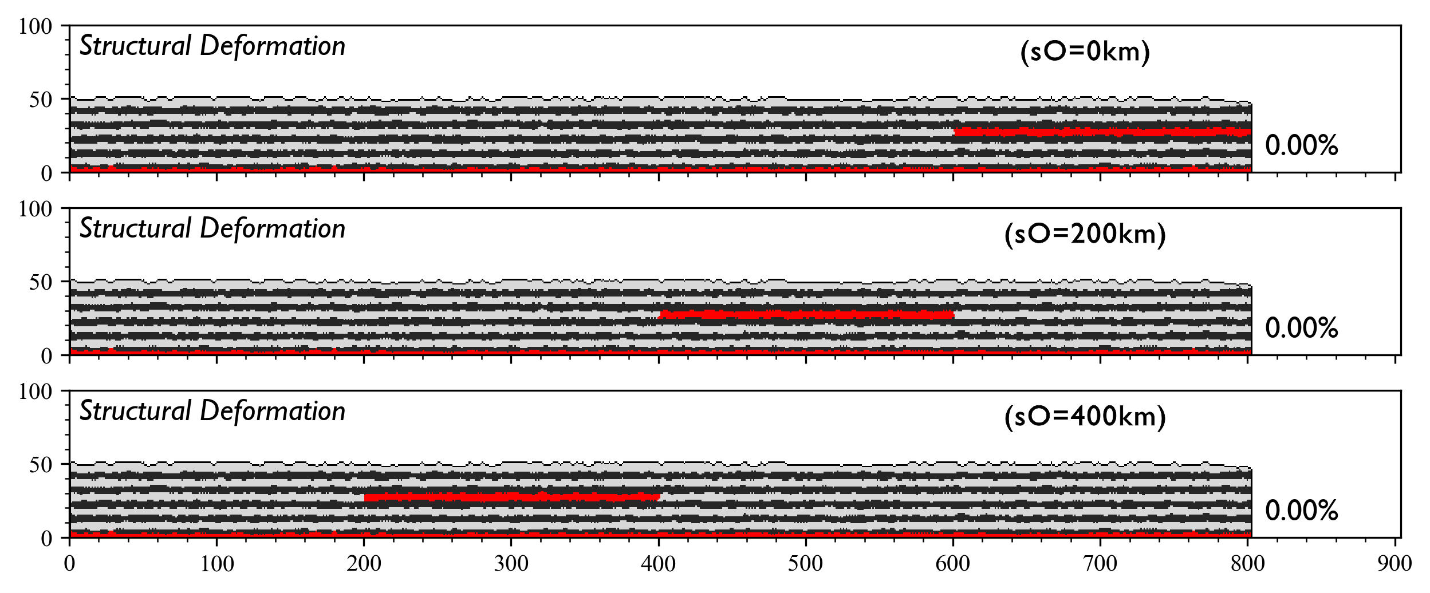



Salt Offset

Slide 34




Fault Orientation

Slide 35




Fault Inclination(+)

Slide 36




Fault Inclination(-)

Slide 37




Fault Depth(+)

Slide 38




Fault Depth(-)

Slide 39


Fault Offset(+)

Slide 40


Fault Offset(+)

Slide 41


Fault Offset(-)

Slide 42


Fault Offset(-)

Slide 43




Fault Scale-Bottom(+)

Slide 44




Fault Scale-Bottom(-)

Slide 45




Fault Scale-Surface(+)

Slide 46




Fault Scale-Surface(-)

Slide 47
Content
Background
Algorithm
Experiment
Discussion
Conclusion

Slide 48
Conclusion
DEMpost is proved to be reliable.
Salt layer influence tectonics a lot.
Pre-existing fracture has a huge impact in many ways.

Slide 49
Acknowledgement
THANKS

